Slide 1
Preparation of teachers for their role in supporting mental health
Dr Gavin hazel, School of Education
Conference: Evidence-Based Approaches in School Mental Health Support

Slide 2
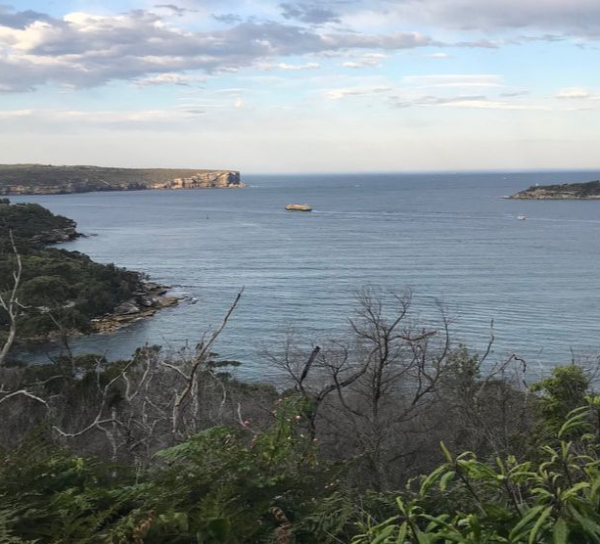
Acknowledgement of country
I would like to acknowledge the traditional custodians of the land on which this work was developed, Wallumattagal people who have been the caretakers of this land for thousands of years. We recognize their continuing connection to Country, their rich cultural heritage, and the wisdom of their Elders, past, present, and emerging.
I extend this acknowledgement to all Aboriginal and Torres Strait Islander peoples who call this region home, as well as those who have ongoing connections to this land. We honour and respect their profound relationship with Country, which sustains and nurtures us all.
May we walk together on this journey of truth-telling, healing, and celebration, embracing the wisdom and strength of the world's oldest living cultures.
Notes:
Source: http://www.rhaehooper.com/contact.html
Headland Artists Precinct - an artistic community housed in converted historic military buildings, overlooking the entrance to Sydney Harbour, surrounded by bush and a sculpture park.

Slide 3

Preparation of teachers for their role in supporting mental health
Notes:
Abstract
Has schooling ever been a practice that has truly occurred outside the domain of mental health and wellbeing? At the heart of the mass schooling enterprise there is a fundamental requirement for collaborative and relational action in the support of student outcomes.
While this may seem self-evident, we are nonetheless faced with the question of how well equipped are teachers (for the schooling contexts of today and the near future) when it comes to the skills and dispositions necessary for working effectively with other disciplines and professions invested in the Educational enterprise.
As the purposes, expectations and contributions of schooling shift and align with community, policy, and government priorities there is both a pragmatic and theoretical benefit in a transdisciplinary turn.
Adopting a transdisciplinary perspective allows us to view mass schooling practice though a lens that has been usefully applied to other key social systems that work with children, families, and communities. Furthermore, a transdisciplinary position encourages us to reconsider the social structures, regimes and discourses that characterise mass schooling; and the degree to which these aspects enable or inhibit the transformative processes that are required to move us towards more progressive goals for schooling.
This presentation will examine key theoretical concepts that are implicated in the effective preparation of teachers for transdisciplinary partnerships and provide lessons learned from both whole of school and sector transdisciplinary collaboration to support policy, practice, and reform for student wellbeing.

Slide 4
The current context
In the next decade conservative projections predict that 3 million children will be born. We need to understand how to best strengthen families and children, so they possess the necessary skills to achieve self-sufficient, healthy and secure lives. We must also transform the ways in which we think about supporting vulnerable children and young people.
Advances in neuroscience, developmental biology, behavioural science, learning science, and pedagogic practice are providing us with the evidence needed to build on best practices and to develop new ideas that can address the factors that contribute to positive outcomes for children and young people.

Slide 5

Existing programs, policies and partnerships have produced long term benefits for individuals and society but the quality of implementation, the magnitude of impacts and integration of programs into a complementary system have been inconsistent at best.
If we want to achieve better outcomes for children, we must continue to aim higher. One promising pathway to achieve this is to focus on fostering skills in key professions and that will allow them to become (or to be) better enablers of positive outcomes.

Slide 6
Defining the problem space
The volume and nature of need across the domains of promotion, prevention, early intervention and recovery is beyond the current or likely future capacity (given current clinical models and increasing diversification of clinical categories) for the system to achieve outcomes
Innovative service system designs, application of technologies can provide, at a minimum, a stop gap and at their best create a possibility space, resource allocation and transdisciplinary framework.
In this context we must look to how we can optimise, under real world conditions, our clinical and allied service system responses.

Slide 7

Solution space
For effective solutions, we need to rethink our care system, starting with altering our perspective.
Implementing this new perspective requires us to develop capabilities and seize opportunities presented by "others" who are now involved in these viewpoints.

Slide 8
Centre on the Developing Child
Every system that touches the lives of children offers an opportunity strengthen the foundations and capacities that make lifelong healthy development possible.

Slide 9
Locating wellbeing in Education and Teaching
Australian schools systems are moving towards a more systematic and comprehensive recognition of the interrelationship between academic outcomes, wellbeing and personal development.
Emery Cowen observed that it is possible to create “educational experiences that not only transmit knowledge, but do so in ways calibrated to advance wellness. Education’s potential, in this regard, has not yet sufficiently plumbed”.
Notes:
Emery Cowen advocated an approach called “Community Psychology”. This approach shifted the emphasis of psychological intervention from the individual to community level. This acknowledges that the promotion of wellness need interventions beyond one-on-one counselling.
He observed with relation to education and schools: “Education represents a potentially powerful, but not yet well-harnessed, force for advancing wellness. At an obvious level, the child's educational experiences provide the skills and knowledge bases needed to master essential life tasks. Less directly, these experiences also shape children's competence and efficacy views and, with these, a sense of control over their fate” (Cowen, 1991).
Cowen was based at the University of Rochester and was instrument in the Primary Mental Health project (a school based project for the early detection and intervention fro school maladjustment) which commences in the 1950’s and is till ongoing, the Rochester Resilience Study and other community interventions.
Cowen proposed five wellness enhancement goals: “(a) forming wholesome caregiver-child attachment relationships; (b) children’ s acquisition of early, stage-salient competencies; (c) creating influential wellness-enhancing environments, as for example schools, in which children spend much time in their formative years; (d) learning to cope effectively with stressful life conditions and (e) developing a sense of empowerment i.e. of being in control of one’ s fate”.

Slide 10

Now for the challenging idea
A comprehensive (holistic) approach inherently demands inclusivity and cross-disciplinary collaboration that our current systems lack.
It's not just preferable but imperative to include diverse groups for a truly comprehensive understanding and improvement of wellbeing.
These groups are not merely an added bonus; they are a vital component of the ecosystems of our developmental, educational, and care systems.
Their involvement is critical, though not the only element needed, for the resolution.

Slide 11
Capability Development – Lessons Learned
Since 2000 the Australian government has actively supported, initial teacher training and in-service preparation of, teachers to contribute through their day-to-day practice to the social and emotional wellbeing and learning of children and young people.
In Australia, many state and territory educational organisations are implementing policies and frameworks that relate to social and emotional wellbeing and are providing support to schools to become involved in whole-school wellbeing promotion.
Research suggests that the most effective school-based strategies are founded on comprehensive whole-school approaches in which promoting social and emotional wellbeing becomes a sustained and integrated process in the school and part of the core business of the whole-school community

Slide 12

The crux of the issue
How well equipped are teachers (for the schooling contexts of today and the near future) when it comes to the skills and dispositions necessary for working effectively with other disciplines and professions invested in the Educational enterprise?
Notes:
The crux in mountain climbing is the most difficult section of a route, or the place where the greatest danger exists.

Slide 13

Strategies
Help
Help young children develop strong, adaptive capacities by increasing protection and supports provided to them by professionals present and invested in their day to day lives.
Build
Build workforce and system capacity at the point of entry into child and youth professions by providing skills training.
Ensure
Ensure integration of appropriate knowledge skills and attitudes into professional preparation and ongoing accreditation by providing an overarching capability model.
Ensure
Ensure articulation from basic preparation to ongoing professional development by connecting processes through a common core skills framework.

Slide 14
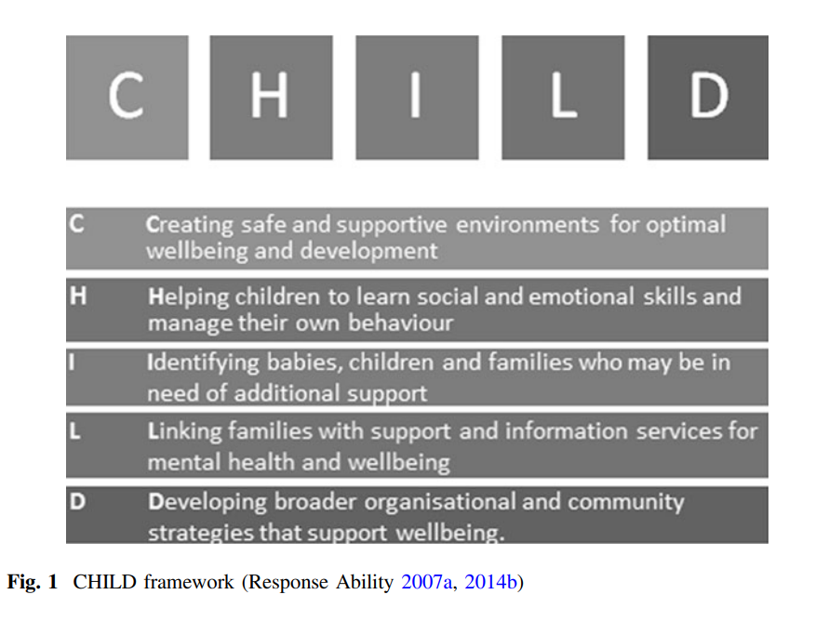

Slide 15
Turn key conditions for preparing teachers
Provision of evidence-informed and sector appropriate co-created resources and professional support;
Consultation, collaboration, and workforce capacity building;
Advocacy of changes to curriculum, competencies, policies, procedures, and codes of professional practice; and
National leadership in policy, research, and practice.

Slide 16
Enablers of change
Congruence and consistency
Support for disruption and consolidation
Narrative of change
Robust and real time data and adjustment

Slide 17
Considerations
Low threshold to participation (inclusive and comprehensive to building community for change).
Bandwidth creatively leveraging but not being dependent on technology.
Critical mass of initiatives across the health and educational spectrum.
Fidelity not a function of scale – looking for interventions that have reach across scale or can arrogate with others to create virtuous chains of advantage.
Notes:
Gavin’s points

Slide 18
Every idea for moving forward should be tested against two simple questions: “Is it good for kids?” and “Will it help the health and well-being of the child and her/his family?”
Source: With Our Best future in Mind
The central question is not: “what about the students is causing the performance discrepancy?” but “what about the interactions of the curriculum, instruction, learners and learning environment should be altered so that the students will learn?”
Source: Ken Howell

Slide 19
Take home message
We need a model that brings together all the things that help teachers, students, parents and communities make better choices and cope with the demands of schooling and learning.
We need tools, language, and conversations that allow us to move forward.

Slide 20
Background material

Slide 21
What do we know: The contribution that teachers make to student outcomes?

Slide 22
Identifying what matters (Hattie, 2003)
Students 50% (variance of achievement)
Home 5-10% (variance of achievement)
Schools 5-10% (variance of achievement)
Principals Accounted under school effects
Peer 5-10% (variance of achievement)
Teachers 30% (variance of achievement)
Notes:
Hattie, J. (2003). Teachers make a difference – what is the research evidence?
There are many outcomes of schooling, such as attitudes, physical outcomes, belonging ness, respect, citizenship and the love of learning. This book focuses on achievement and that is a limitation of this review.

Slide 24
Hattie (2003)
It is what teachers know, do, and care about which is very powerful in the learning equation
Notes:
Teachers are among the post powerful influences in learning.
Teachers need to be directive, influential, caring, and actively engaged in the passion of teaching and learning.
Teachers need to be aware of what each and every student is thinking and knowing to construct meaning and meaningful experiences in light of this knowledge, and have proficient knowledge and understanding of their content to provide meaningful and appropriate feedback such that each student moves progressively through the curriculum levels.
(NB Expert teachers meet and work together to constantly improve towards this ideal).
Teachers need to know the learning intentions and success criteria of their lessons, know how well they are attaining these criteria for all students, and know where to go next in light of the gap between students’ current knowledge and understanding and the success criteria of: “Where are you going?”, “How are you going?” and “Where to next?”
Teachers need to move from the single idea to multiple ideas, and to relate and then extend these ideas such that learners construct and then reconstruct knowledge and ideas. It is not the knowledge or ideas, but the learner’s construction of this knowledge and these ideas that is critical.
School leaders and teachers need to create school, staffroom, and classroom environments where error is welcomed as a learning opportunity, where discarding incorrect knowledge and understandings is welcomed, and where participants can feel safe to learn, re-learn, and explore knowledge and understanding.

Slide 25
WHAT IS EXPECTED: How do we represent this in practice?

Slide 26
Responsibility of teachers
Significant responsibility in preparing young people to lead successful and productive lives.
Creating:
Successful learners
Confident and creative individuals
Active and informed citizens
Notes:
Indicated by the performance on standardised assessment

Slide 27


Slide 28
Key part of teachers work that go to the goals of schooling
Partnerships
Relationships
Server and return
Intentional/unintentional learning
Intentional/purposeful nature of teaching: Teaching is undertaken for a purpose
Decision making

Slide 29

Effective teaching may be a matter of:
    a caring person with,
    the right knowledge,
    being available,
    in the right place,
    at the right time.
Notes:
Text from Mort Silver slides on Suicide Prevention

Slide 30
Why Prepare Teachers for mental health promotion?

Slide 31

Most Cited Reasons
(1) Psychosocial & MH problems often are major factors interfering with effective school performance of some students so schools must do something about these individuals (especially mental health services are included in a student’s special education plan).
Notes:
Source: Mental Health in School & School Improvement: Current Status, Concerns, and New Directions http://smhp.psych.ucla.edu/mhbook/mhbooktoc.htm

Slide 32
(2) Mental health agencies view schools as places where the availability of and access to services and those who need them can be enhanced.
Notes:
Source: Mental Health in School & School Improvement: Current Status, Concerns, and New Directions http://smhp.psych.ucla.edu/mhbook/mhbooktoc.htm

Slide 33
(3) Schools increasingly are seen as needing to play a greater role in facilitating social-emotional development and learning.
Notes:
Source: Mental Health in School & School Improvement: Current Status, Concerns, and New Directions http://smhp.psych.ucla.edu/mhbook/mhbooktoc.htm

Slide 34
More than Sutton’s Law
Other Reasons to Choose Schools
Mental health is directly linked to educational outcomes.
Schools are the optimal place to develop psychological competence and to teach children about making informed and appropriate choices concerning their health and many other aspects of their lives because schools are the only organization in our society to which virtually all children and adolescents are consistently exposed for extended periods of time.
Schools are vital and central community institutions.

Slide 35
Other Reasons to Choose Schools
As multidisciplinary entities, schools are the best places to integrate and to coordinate the efforts of teachers, families, mental health service providers, and administrators to foster the mental health of students.
Accessible, affordable mental health services are most easily and consistently provided in the educational setting.
Problems of transportation, accessibility, and stigma are minimized when such services are provided in schools.

Slide 36
Mental health in schools isn’t just about
  Students with diagnosable problems
  Therapy and behavior change
  Connecting community mental health providers to schools
  What mental health professionals do
  Empirically-supported treatments

Slide 37
In addition to all the above, mental health in
schools also is about
• providing programs to promote social-emotional development, prevent mental health and psychosocial problems, and enhance resiliency and protective buffers
• providing programs and services to intervene as early after the onset of learning, behavior, and emotional problems as is feasible

Slide 38
building the capacity of all school staff to address barriers to learning and promote healthy development
• addressing systemic matters at schools that affect mental health, such as high stakes testing (including exit exams) and other practices that engender bullying, alienation, and student disengagement from classroom learning

Slide 39
drawing on all empirical evidence as an aid in developing a comprehensive, multifaceted, and cohesive continuum of school-community interventions to address barriers to learning and promote healthy development

Slide 40
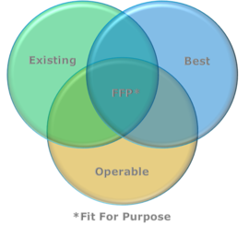
Evidence informed practice
Best Practice
Existing Practice
Operable Practice

Slide 41
Schools best promote mental health when they:
create supportive classroom and school environments that promote social inclusion and foster in students and families a sense of belonging and school connectedness.
promote respectful communication and positive relationships between all members of the school community, including students, school leaders, school staff, parents and families.
encourage mental health literacy and a culture of mental health promotion among all members of the school community, including students, school leaders, school staff, parents and families.
foster students’ personal, social and emotional development, including social skills, interpersonal communication, negotiation, problem-solving, decision-making, emotional literacy and the capacity for self-regulation.

Slide 42
provide diverse opportunities for students to actively engage with a meaningful and challenging curriculum, to participate in extra-curricular activities and to connect with the wider community.
provide authentic choices and leadership opportunities for students within the curriculum and the school community, allowing students to exercise initiative and to develop a sense of autonomy and agency.
provide opportunities for all students to experience competence and celebrate success in some area of school life (eg academic, extra-curricular or community service) to foster a sense of self-efficacy and achievement.
foster students’ development of positive health attitudes and behaviours that will support their psychological wellbeing, personal safety and physical health in adolescence and into adulthood.

Slide 43
Schools best contribute to the prevention of mental illness when they
ensure that all members of the school community can acquire a developmentally-appropriate understanding of mental health problems, mental illnesses, help-seeking behaviour and approaches to risk reduction.
provide learning opportunities and school environments that will reduce the proportion of young people exposed to key risk factors, such as bullying and harassment; discrimination and exclusion; use of alcohol and other drugs; and physical health problems such as injury and communicable illnesses.
facilitate students’ access to conditions and support services that will allow their fundamental physiological and psychological needs to be met (eg housing, physical safety, nutrition), in order to support wellbeing and learning.

Slide 44
provide additional support for those students who already have a higher risk of experiencing a mental illness, such as those who have experienced loss or trauma, those who have been abused, those who have chronic illness and those whose parents have a mental illness.
facilitate and promote students’ access to specialist support services when students are experiencing psychological distress or other potential symptoms of mental health problems or mental illness.

Slide 45
Example of targeted capability development for MH promotion
What is abundant? – People and systems that are in contact with children
What is scarce? – Health promotion and mental health professionals
How do we make knowledge, skills and attitudes about mental health promotion and wellbeing more accessible to more people?
Notes:
Look for opportunities to have influence and impact.

Slide 46

Case study
Separating the clinical and educational goal – focusing on wellbeing and growth as the superordinate objective
Disrupting the primacy of the medical model
Addressing the “education as therapy” dialogue

Slide 47
Vision: In practice we …
Transform Knowledge and Evidence
Communicate with intent to selected audience
Advocate for the long term use of professional groups as change agents
Build partnerships and collaborations
Encourage general and targeted behavioural change
Enable and support implementation
Notes:
support the best use of available evidence;
disseminate relevant and critical information;
develop informed policy and establish effective research initiatives and workforce development.

Slide 48

Shanker’s emerging questions
What are the capacities that children need in order to flourish in a modern school environment?
What sorts of experiences promote the development of these capacities?
What sorts of biological and/or social factors can undermine or impede these experiences?
To what extent can such deficits or constrictions can be mitigated and the child returned to a healthier developmental trajectory?
Notes:
The capacities that we have in mind are those that enable a child to master her emotions and thus attend to the world (i.e., those that are grouped together under the rubrics of emotion- and self-regulation and executive functioning); to form a strong attachment with her primary caregivers; to engage in back-and-forth communicative interactions with her caregivers, which involves the development of intentional or purposeful behaviour; to engage in sustained, joint problem-solving with her caregivers; and then, to develop symbolic and language capacities and the capacity to think logically and reflectively.

Slide 49

Essential qualities of the helper
• Respect
• Genuineness
• Empathy
• Humility
• Quiet enthusiasm
• Personal strength and integrity
• Intellectual and emotional attunement
Source: Family Partnership Model
Notes:
Family Partnership Model
The Family Partnership Model is an innovative approach based upon an explicit model of the helping process that demonstrates how specific helper qualities and skills, when used in partnership, enable parents and families to overcome their difficulties, build strengths and resilience and fulfil their goals more effectively.
Source: http://www.cpcs.org.uk/index.php?page=about-family-partnership-model
New link: https://www.cpcs.org.uk/fpm/

Slide 50
Skills
Concentration/Active listening
Prompting, exploration and summarising
Empathic responding
Enthusing and encouraging
Enabling change in feelings, ideas and actions
Negotiating
Communicating and making use of technical knowledge, expertise and experience
Problem management
Source: Family Partnership Model

Slide 51

Candidate principles and metrics for establishing efficacious interventions for preparation of teachers
Process over product
Fitment
Dynamic value add
Consider measures of trustworthiness of the implementation (pace Lincoln and Guba)
  Credibility
  Transferability
  Dependability
  Confirmability
RE-AIM: reach, effectiveness, adoption, implementation, maintenance
Notes:
A construct’s range of convenience comprises all those things to which the user would find its application useful.
A construct’s focus of convenience comprises those particular things to which the user would find its application maximally useful.
The context ... is somewhat more restricted than the range of convenience ... somewhat more extensive than the focus of convenience

