Slide 1




28 April 2025
School Mental Health for ALL
Effective skills and strategies for ALL teachers and school staff
SOFA and SMHILE
Prague, Czechia
Eric J. Bruns, Ph.D.
University of Washington
School Mental Health, Assessment, Research,
and Training (SMART) Center
Seattle, USA

Slide 2
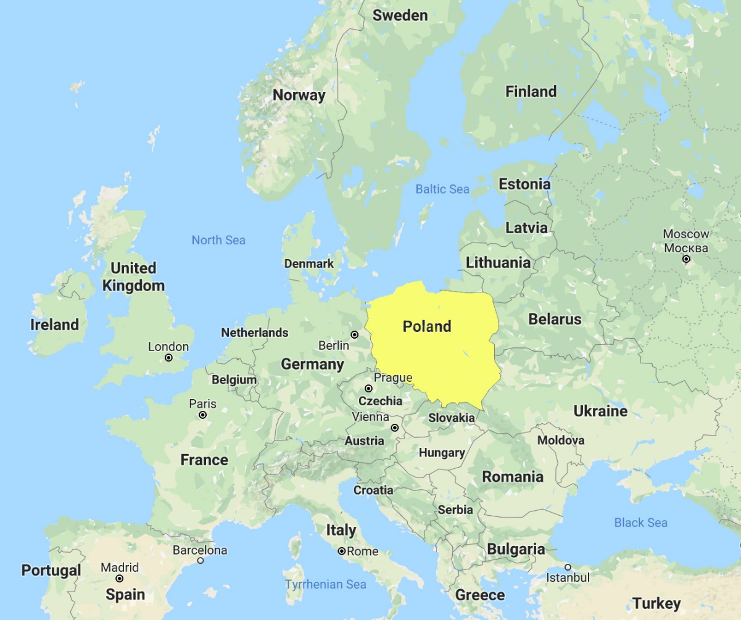
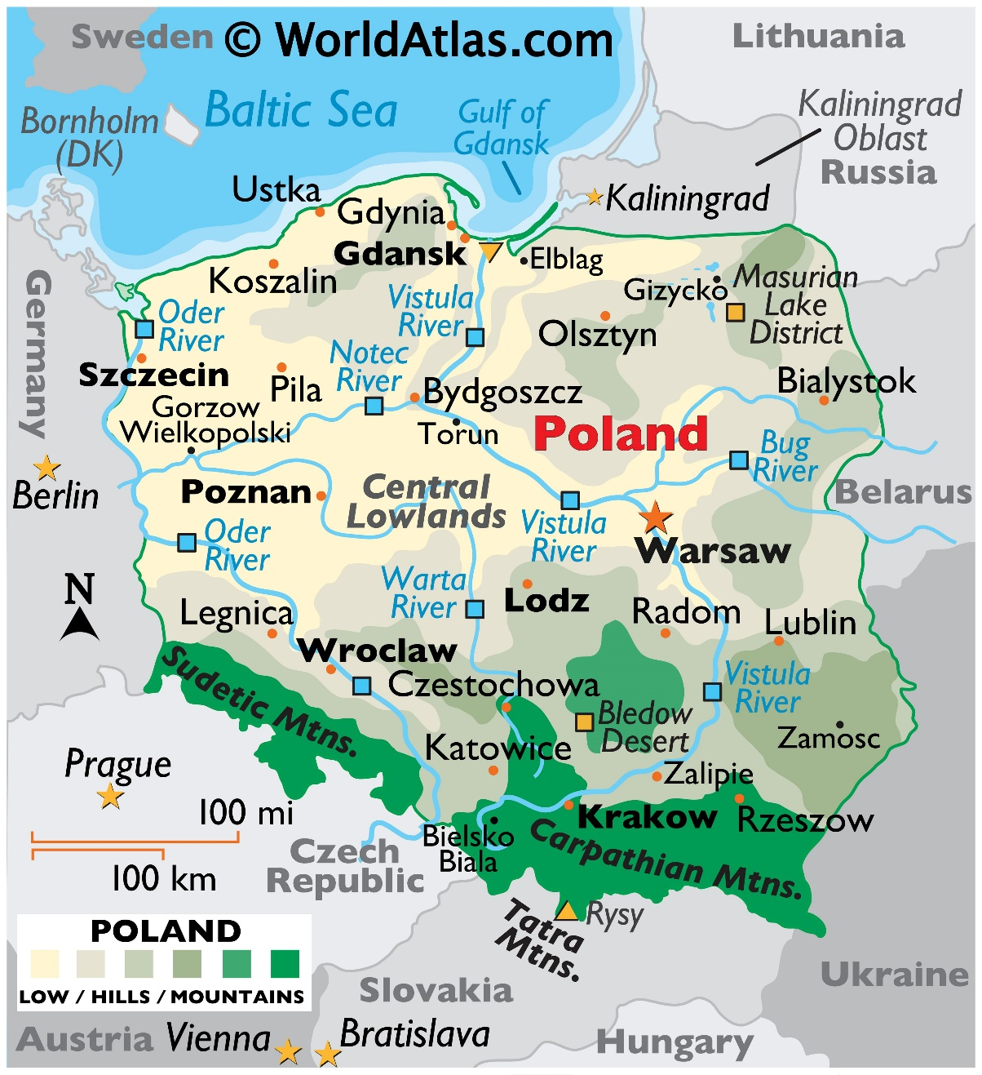
April 1-5
~10 trainings
March 28-31
~10 trainings

Slide 3

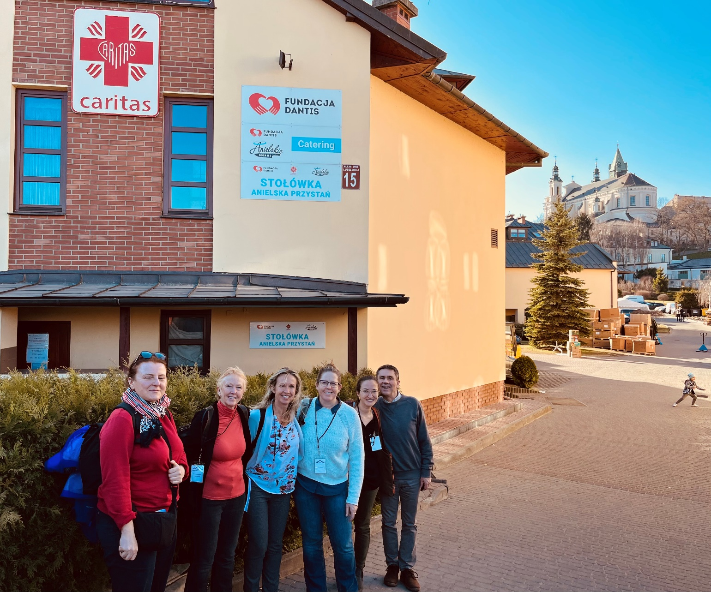
Notes:
Kira/Tona from here

Slide 4
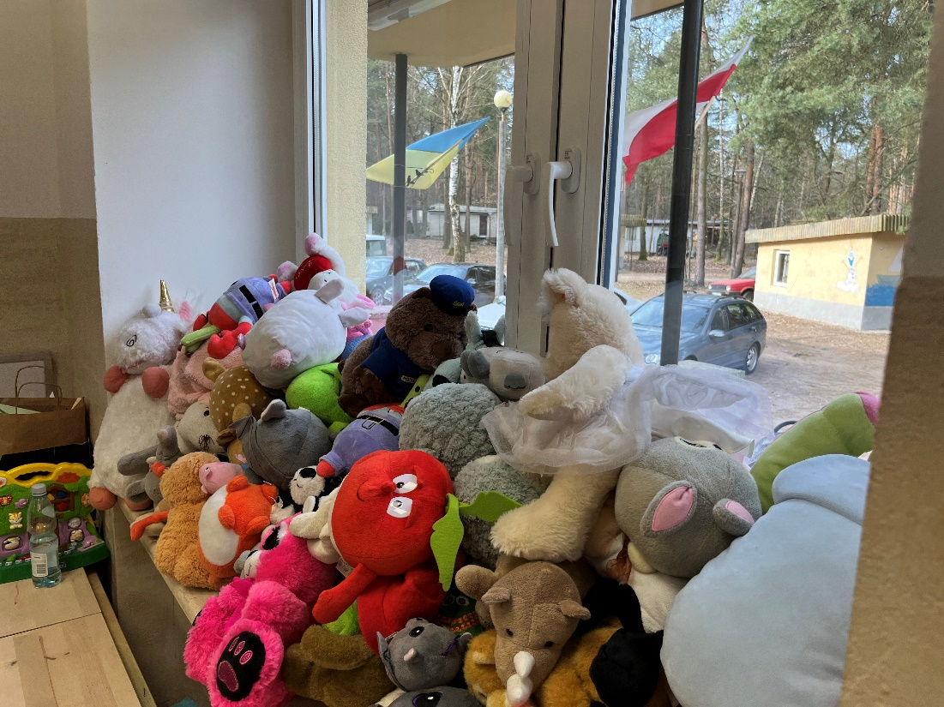
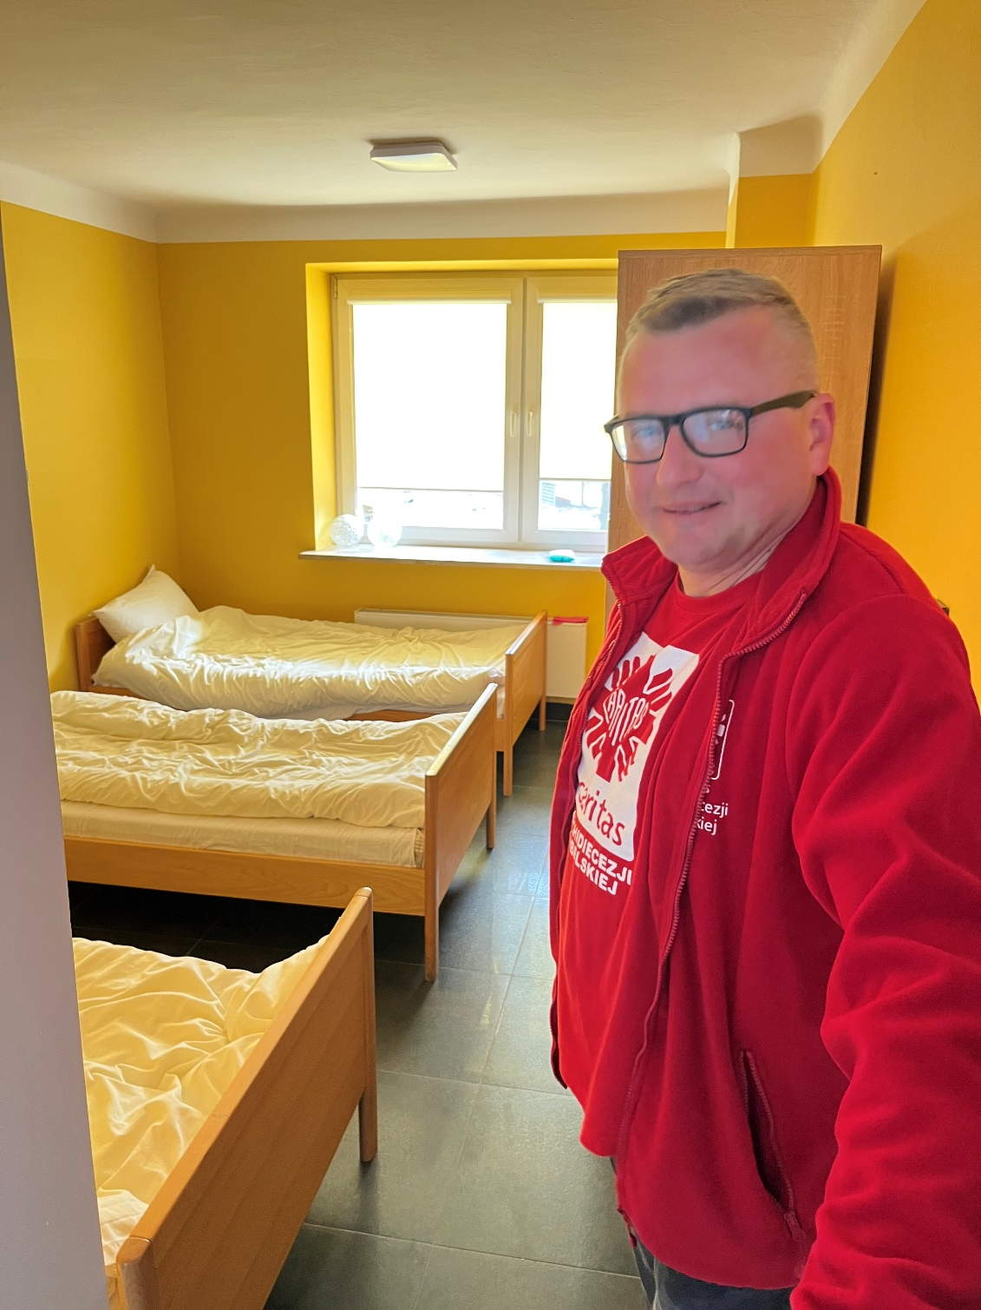
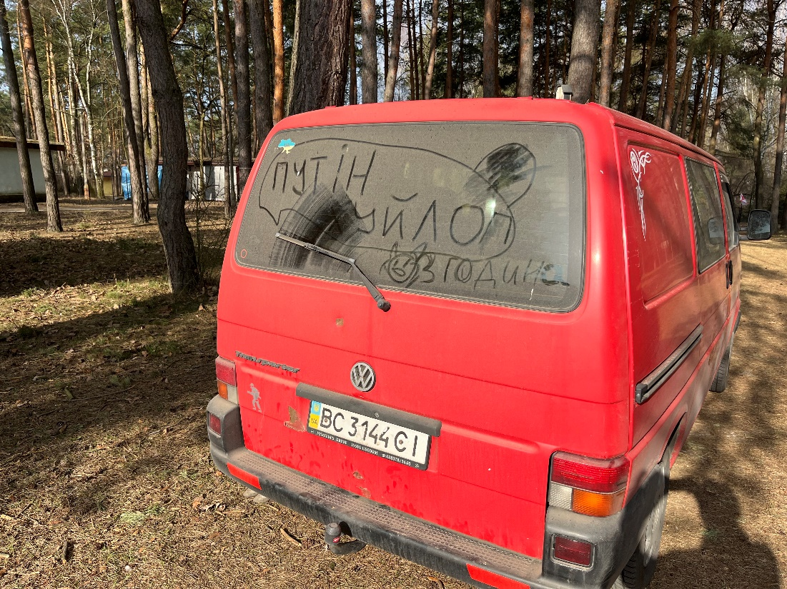
Notes:
Putin is a dickHEAD ☺

Slide 5
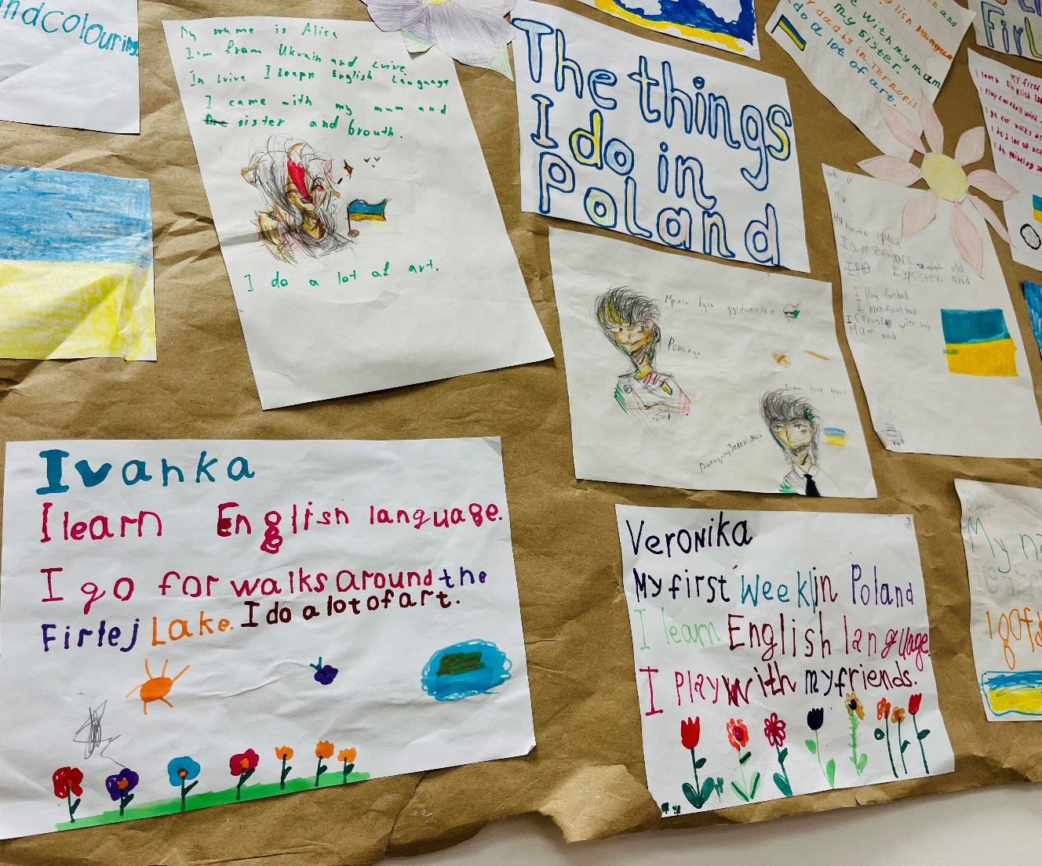
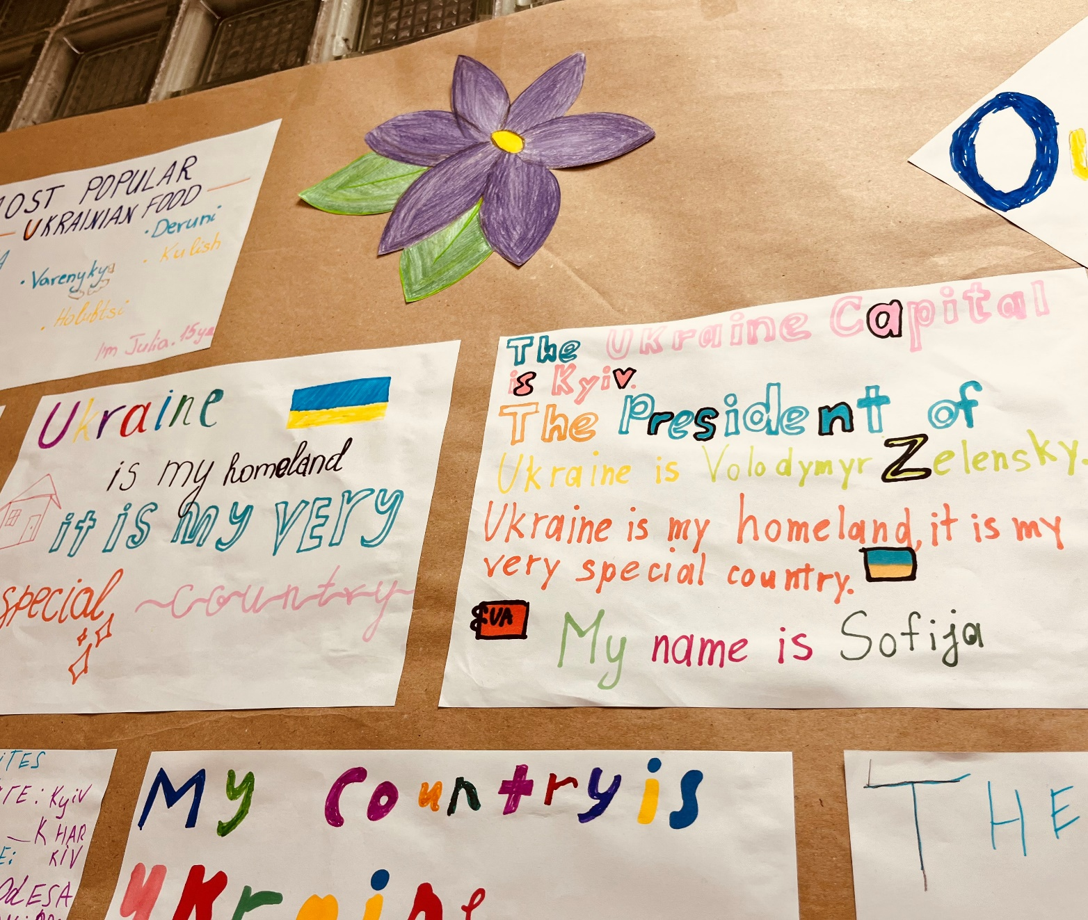

Slide 6
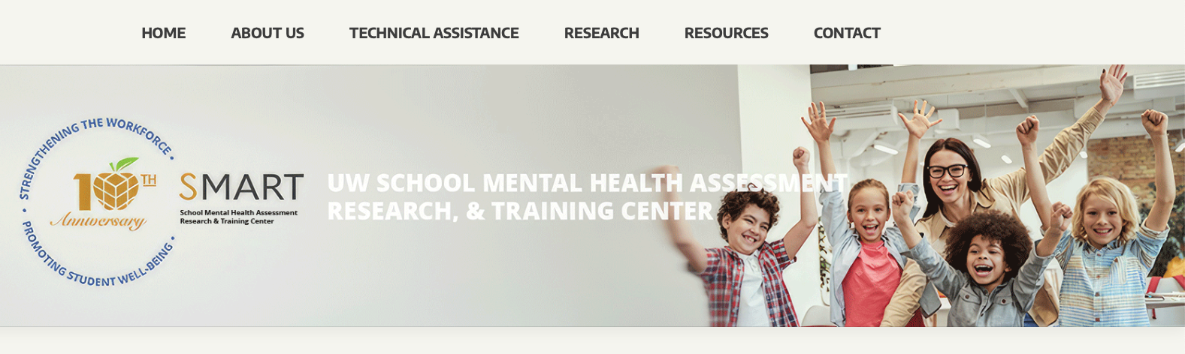
https://smartcenter.uw.edu

Slide 7



Slide 8

SMART CENTER MISSION
RESEARCH
To promote high-quality programs, practices, and policies to meet the full range of social, emotional, and behavioral needs of all students.
TRAINING,
TA & EVAULATION
POLICY

Slide 9

The SMART Center’s work
Active projects in…
  720 school districts
  ~3,600 school buildings
>$48 Million in research grants

Slide 10
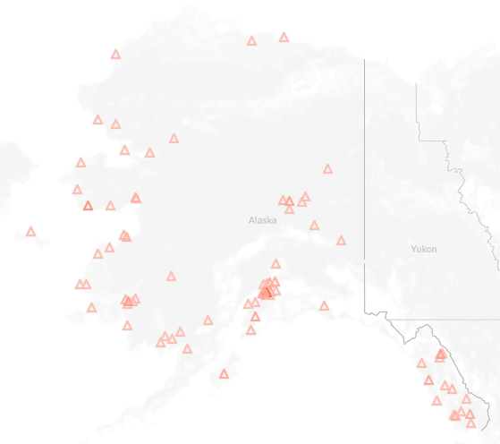
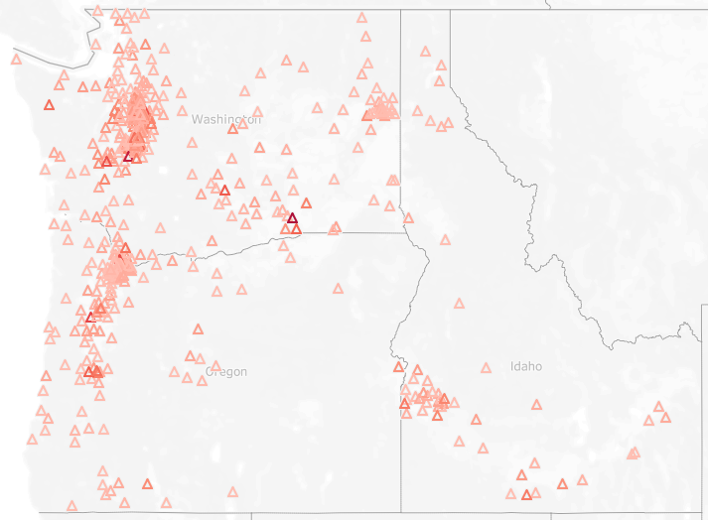
SMART Center trains in hundreds of schools and communities in the Northwest U.S.

Slide 11


Some Ways to Build School Mental Health for All
BUILD Systems, Teams, and Partnerships
BOOST Student – Teacher Relationships
PROVIDE Brief, Accessible Interventions
USE Paraprofessionals and Task Shifting

Slide 12
BUILD PARTNERSHIPS:
High-Quality School Mental Health Happens
When Schools and Communities are in Partnership.
SCHOOL PROVIDERS
COMMUNITY PROVIDERS
3
3
2
2
1
1

Slide 13
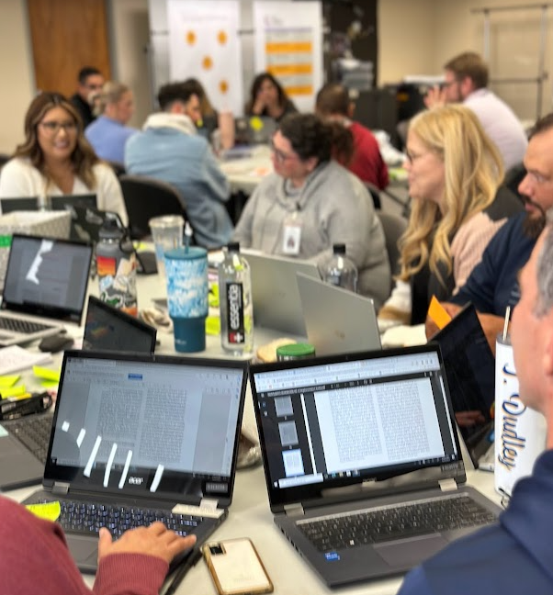
1. Build Partnerships
  Establish District & School-community teams
  Inventory and strategically de-implement current projects
  Select, implement effective programs across tiers
  Screen students for mental health concerns
  Use data to support decision making

Slide 14
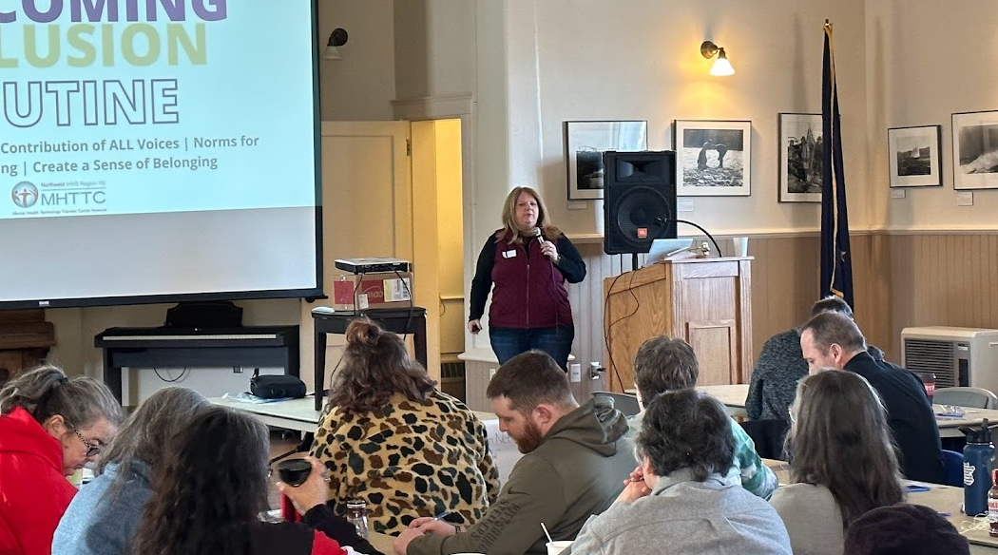
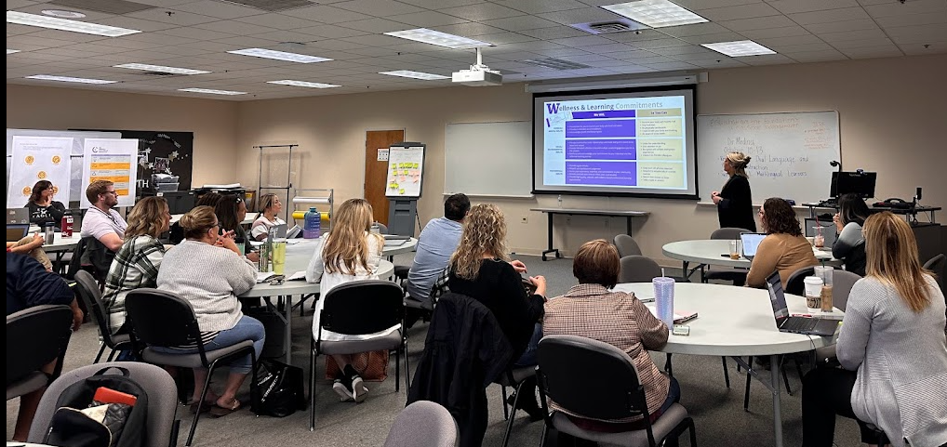

Slide 15
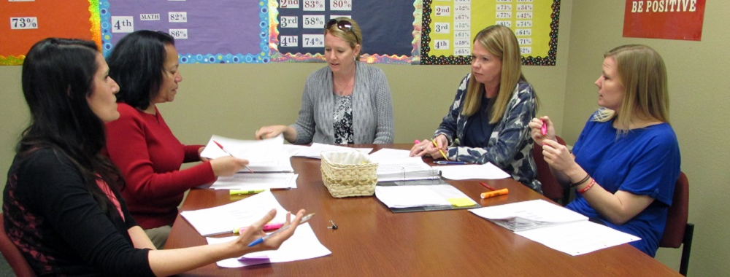
Interconnected School Mental Health Schools Show Better Team Functioning
GREATER TEAM
PARTICIPATION
BY principals, school
counselors, school
psychologists, and school
mental health clinicians
GREATER COMMITMENT
TO TEAM MEETINGS
25 minutes longer
MORE TIER 1 PROBLEM-
SOLVING DISCUSSIONS
Using data to address
issues discussed
3.7 times more team
meetings per quarter
(w/more productivity!);
Source: Splett, Perales, Miller, Halliday-Boykins, & Weist, 2019
Notes:
Schools in the ISF condition reported having more meetings discussing tier 1 (3.7 more meetings per quarter) and greater attendance by school counselors compared to the PBIS-only condition. The ISF condition also had longer meeting times (~25 minutes longer) and greater attendance from principals, SMH clinicians, and school psychologists compared to both the PBIS-only and PBIS+SMH conditions.

Slide 16
REVIEWING DATA
High Levels of Problem Behavior
Leading to Discipline Events in the School

Slide 17
Tier 3 Menu of Individual Supports for a FEW:
  Behavior Intervention Plans
  Safety Planning for Youth with Suicidality
  Cognitive Behavior Therapy
  “Tier 3 Wraparound” teaming
Multi-Tiered System
of SCHOOL MENTAL HEALTH Supports (MTSS)
TARGETED/
INTENSIVE
FEW Students
Individual Interventions
Progress monitoring
Tier 2 Menu of Selected Supports for SOME:
  Behavioral contracting
  Brief Assessment, Treatment, & Triage
  Mentor-based programs, e.g., Check In Check Out
  Group social-emotional skills training
SELECTED
SOME Students
Small Group &
Individual Strategies
Screening
Tier 1 Menu of Supports for ALL:
  School-wide PBIS
  Positive relationships with all students
  Social-emotional learning (SEL)
  Evidence based prevention, E.g., Good behavior Game
  Effective Classroom Practices
UNIVERSAL
ALL Students
School/class-wide, Culturally Relevant
Systems of Support
Notes:
Along the continuum schools populate the tiers of support according their student’s needs. When MTSS is in place, you have the programs and a framework that helps ensure all school staff in the building and all stakeholders in a district are on the same page about what the interventions and strategies are available for all students. Take a look for a moment to see what is on this menu of supports across all three tiers. Also note the importance of screening to detect students and progress monitoring to assess impact. Just like if we were providing reading interventions we must monitor for impact – but all too often with MH services we just count the number of students accessing services.

Slide 18
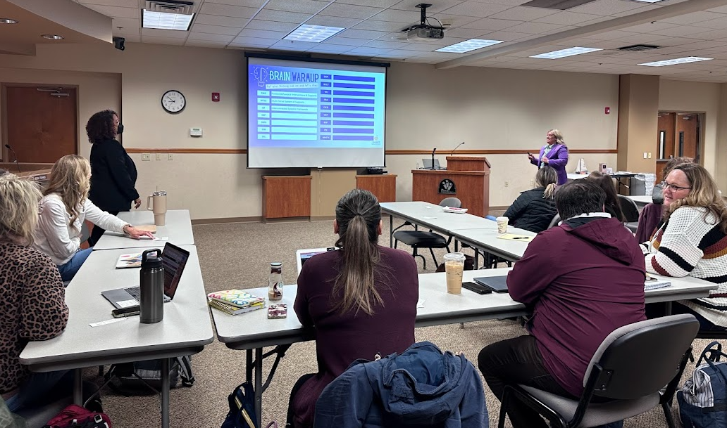
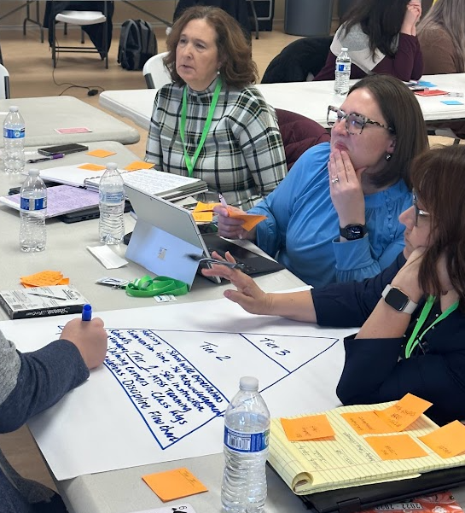
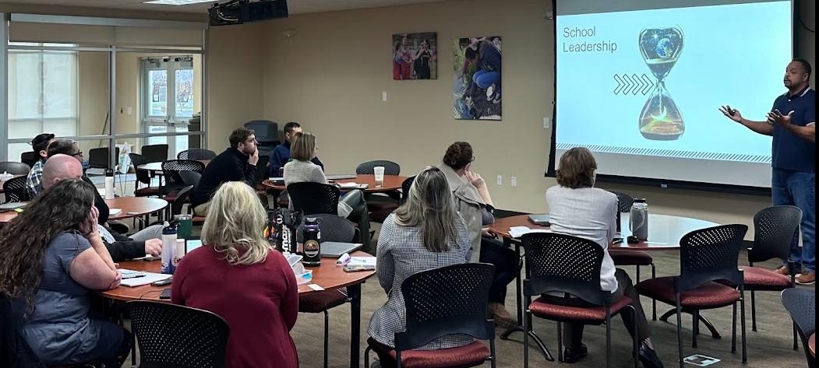

Slide 19
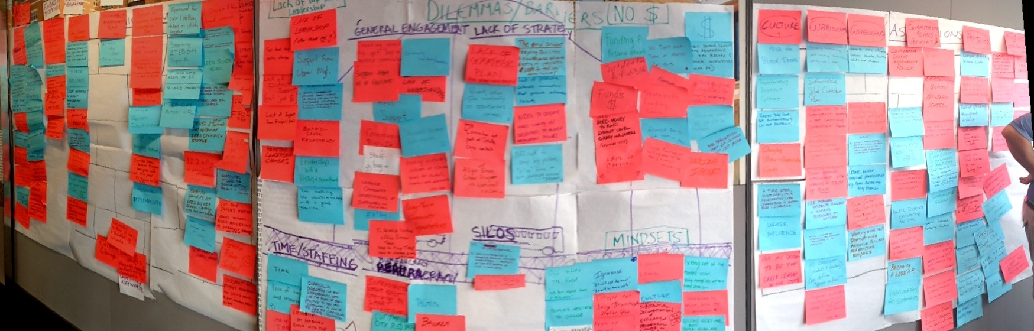
Do NOT Just “Add More Programs”
The typical school operates 14 different Tier 1 programs
…implemented with poor quality.
(Gottfredson et al., 2010)

Slide 20





2. BOOST
Student-Teacher Relationships
Social, Emotional & Behavioral Health
School Engagement
Academic Achievement
School Belonging

Slide 21
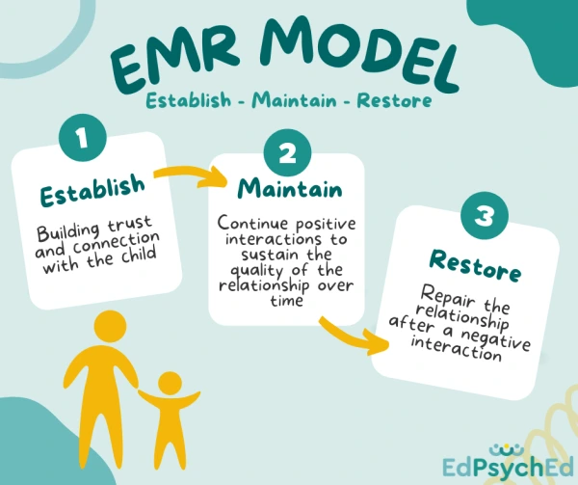
ESTABLISH - MAINTAIN - RESTORE (EMR) Classroom
Strategy

Slide 22
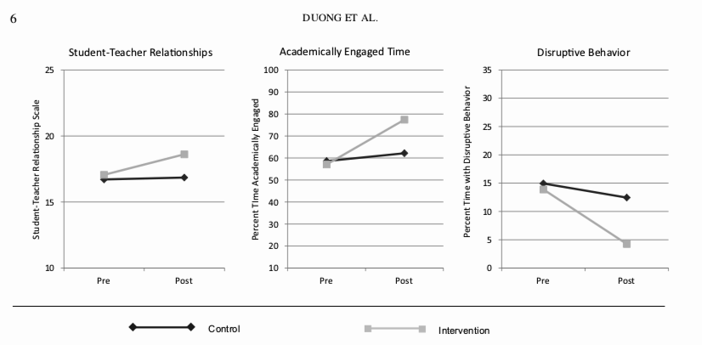
EMR improves relationships, Academic engagement, and Behavior

Slide 23
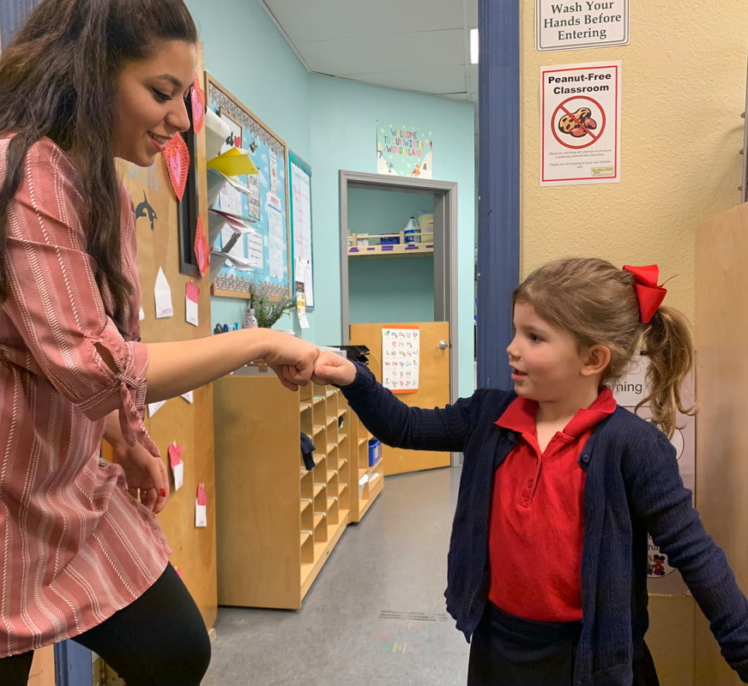


Slide 24
REVIEWING DATA
High Levels of Problem Behavior
Leading to Discipline Events in the School

Slide 25
Positive Greetings started Jan 2024
STUDENT and BUILDING IMPACT
Behavior Problems Reduced Dramatically After adding
Positive Greeting at the Door

Slide 26
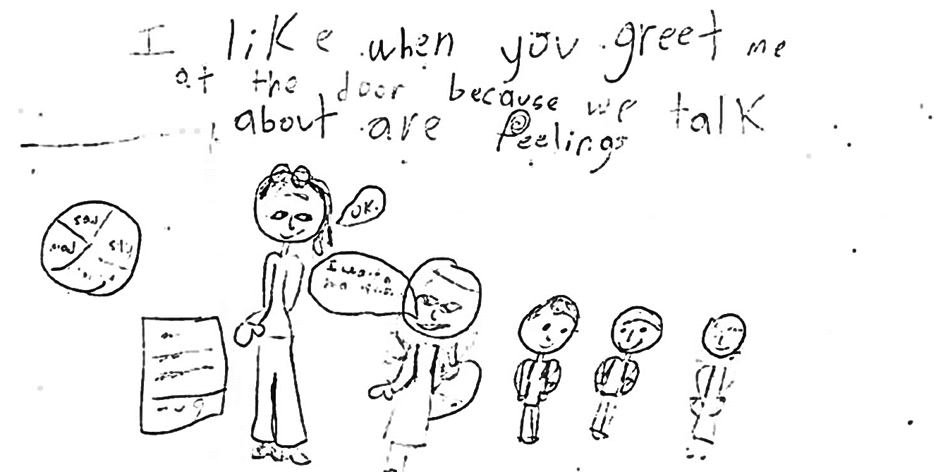

Slide 27
“I like being greeted at the door. It makes me feel nice and makes my day better if I’m feeling down.”
“Greetings at the door are good because they make me feel happy to be here.”
“Greetings at the door help me think better in class and make me happy.”
“A hug everyday helps me concentrate in class and you talk to me when I’m frustrated about the soccer games.”
“I like you giving me hugs. If you rush us and don’t greet us, I would cry.”

Slide 28
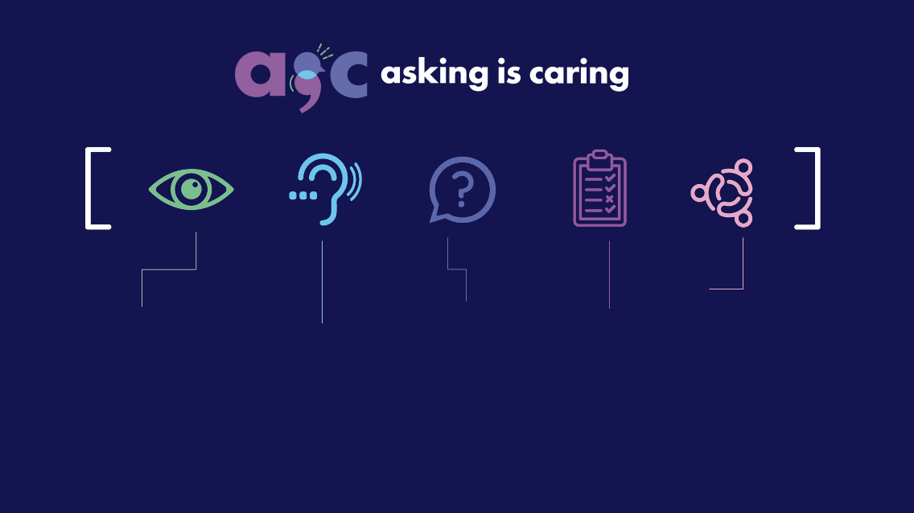
look
many youth are in pain. We need to know what
to look for.
listen
Remember you don’t have to fix things, just listen and try not to
pass judgment.
ask
Asking about suicide doesn't put the idea in their head; ask directly, and
stay calm.
act
Follow protocols.
Offer brief
interventions. Support families.
connect
Activate protective factors. Connect with community resources.

Slide 29


3. PROVIDE BRIEF, ACCESSIBLE INTERVENTIONS
SESSION 1
Engagement, Informal Assessment and Problem Identification
SESSION 2
Problem Solving
Session 3
Continued problem solving + teach skills:
Stress and Mood Management
Realistic Thinking
Communication Skills
Session 4
Review student’s needs & progress to triage
to next steps
Brief Intervention for School Clinicians and Counselors (Bruns & McCauley, 2022)

Slide 30
Students’ status in
Services after 3 months
BRISC PROMOTES efficiency and data-informed triage.

Slide 31
Even though they completed services faster, fewer BRISC students were clinically depression or anxious after 2 and 6 months

Slide 32
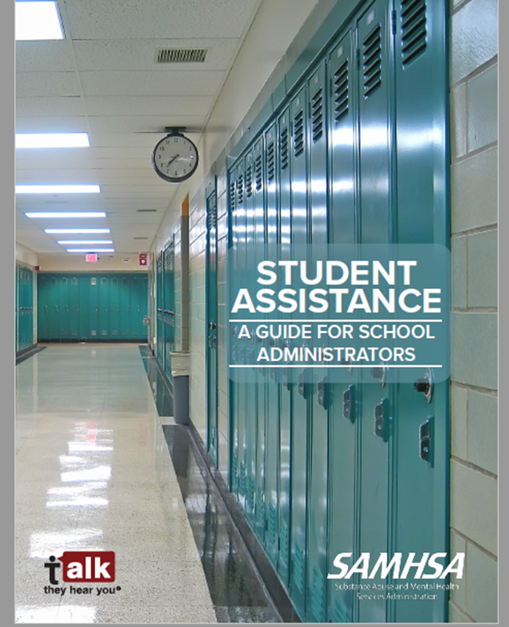

What is a Student Assistance Program (SAP)?
Comprehensive, school-based framework
Designed to provide prevention and early intervention services for students with risk factors for educational failure
Best for students who are experiencing issues with drug/alcohol use and/or mental health problems
Services are integrated and embedded into the school community
SAMHSA - Student Assistance: A Guide for School Administrators
ONDCP - National Drug Control Strategy 2022
Included on SAMHSA's Evidence-Based Resource Center
E

Slide 33
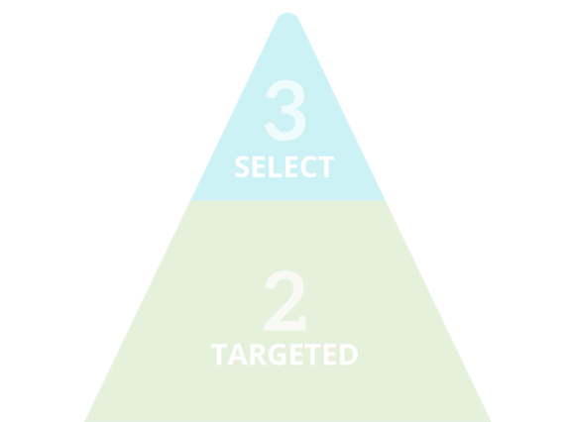

4. USE PARAPROFESSIONALS FOR SCHOOL MENTAL HEALTH
Tier 1
Prevention Activities
Staff awareness presentations
Classroom presentations
Family & community trainings
Youth leadership/prevention/wellness club
Universal prevention campaigns
A

Slide 34
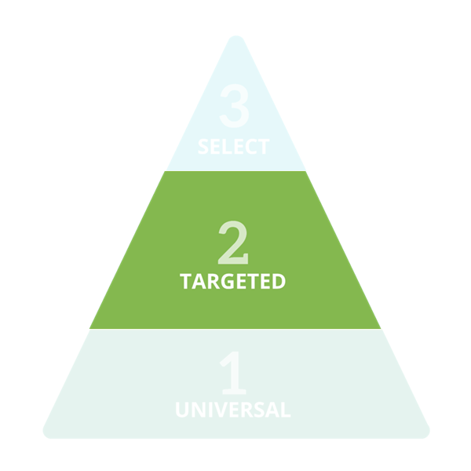
4. USE PARAPROFESSIONALS FOR SCHOOL MENTAL HEALTH
Tier 2
Screening, Intervention
& Referral Out
Multidisciplinary team meetings
Behavioral health screenings
Group & individual interventions
Referrals to additional supports
A

Slide 35
Outcomes for Paraprofessionals:
Just as Positive as for Licensed Clinicians
2023–24 (N = 1,564 students)
43% | Lowered anxiety symptoms (“can’t stop or control my worrying”)
41% | Lowered depression symptoms (“feel unhappy, sad, or depressed”)
38% | Increased self-worth (reduced feeling “worthless or inferior”)
80% | Reported being more likely to attend school (among those with low attendance)
Improved mental and emotional wellness
Source: Student pre/post survey responses in AESD Behavioral Health COVID Response Program 2023/24 school year
E

Slide 36
Student Impacts
2023–24 Snapshot
66% | Decreased physical fighting
65% | Decreased suspensions
62% | Gained healthy strategies to calm down
44% | Gained ability to ask for help when needed
80% | Reported being more likely to attend school (among those with low attendance)
Marked improvement with existing behavior problems
Elevated help-seeking & self-regulation
Source: Student pre/post survey responses in AESD Behavioral Health COVID Response Program 2023/24 school year
E

Slide 37
School Impacts from N=140 school partners
2023–24 Snapshot
99% | Feel it is ‘very important’ or ‘of the highest importance’ to have a Student Assistance Professional available in their school
97% | Feel paraprofessional services improved the school’s ability to respond effectively to students’ health needs
From Staff…
96% | Paraprofessional services increased students’ self-regulation and social skills
94% | Feel the program positively influenced school climate
Source: School Staff survey responses in AESD Behavioral Health COVID Response Program 2023/24 school year
E

Slide 38
Some Ways to Build School Mental Health for All
BUILD Systems, Teams, and Partnerships
BOOST Student – Teacher Relationships
PROVIDE Brief, Accessible Interventions
USE Paraprofessionals and Task Shifting

Slide 39


ERIC BRUNS, PhD
Associate Director, SMART Center
Professor, University of Washington Psychiatry & Behavioral Sciences, Childrens Division
EMAIL: ebruns@uw.edu
BlueSky: @ericjbruns
University of Washington SMART Center

