Slide 1
Embedding best practices into teacher education
Dr Gavin hazel, School of Education
Conference: Evidence-Based Approaches in School Mental Health Support

Slide 2

Acknowledgement of country
I would like to acknowledge the traditional custodians of the land on which this work was developed, Wallumattagal people who have been the caretakers of this land for thousands of years. We recognize their continuing connection to Country, their rich cultural heritage, and the wisdom of their Elders, past, present, and emerging.
I extend this acknowledgement to all Aboriginal and Torres Strait Islander peoples who call this region home, as well as those who have ongoing connections to this land. We honour and respect their profound relationship with Country, which sustains and nurtures us all.
May we walk together on this journey of truth-telling, healing, and celebration, embracing the wisdom and strength of the world's oldest living cultures.
Notes:
Source: http://www.rhaehooper.com/contact.html
Headland Artists Precinct - an artistic community housed in converted historic military buildings, overlooking the entrance to Sydney Harbour, surrounded by bush and a sculpture park.

Slide 3

Embedding best practices into teacher education
Dr Gavin Hazel

Slide 4
20+ year in build capability of educators from early ear to high schools (0-18+)
Translation and implementation
Transdiscipinary teambuilding

Slide 5
Take home message
There is sufficient research, policy, professional, and public support for the proposition that social and emotional wellbeing and learning in central to the work of teachers that there remains no question of whether student wellbeing should be a key element of the role of the teaching profession.
The only remaining questions are about how best to represent and support this key element of professional practice, through elements such as professional standards, initial training, teacher registration, and ongoing professional learning.

Slide 6
Child and Youth: Key Messages
Health is most usefully understood as involving our bodies, minds, brains and relationships.
The mechanisms underlying wellbeing are both physiological and psychological. When we experience challenges to our physical health we need to consider how our psychological health may also be impacted.
We need to understand how we can use this idea of wellbeing to best strengthen families and children so they possess the necessary skills to achieve self-sufficient, healthy and secure lives.
To do this we must also transform the ways in which we think about supporting vulnerable children and young people.

Slide 7
Context to action

Slide 8
Child & Youth
Sectors
Conglomerate of clinical service providers, professional development agencies, advocacy, lobbyist, public and private providers
Increased provision of clinical service provision does not independently address the quantum of need (both known and projected)
Separation of powers: between treatment, prevention, promotion and education activities

Slide 9
Context
Mental health and mental ill health can be influenced by interventions by professional groups
Developmental trajectories are a significant contributor to mental health outcomes
Early Years make identified and significant and distinctive contributions to later development
Clinicians have traditional defined their range of influence as the treatment and prevention of disorders and ill health

Slide 10
Context
We have a gap between knowledge and practice in the clinical domain
Maximum benefits come from a range of approaches, levels of interventions and objectives
Dealing with problems only at the ill health end of the spectrum is costly and avoidable

Slide 11
Summary
Wellbeing and Mental Health are complex and multi-determined, and no one strategy will so provide solution to the issues of health promotion and prevention
01
Effective solutions are ones that increase protective factors and reduce risk factors
02
It is most effective to address multiple levels of influence, and design efforts to work in synchrony
03
There’s no “one-size-fits-all” solution
04

Slide 12
Emerging questions
What are the capacities that children need in order to flourish in a modern school environment?
What sorts of experiences promote the development of these capacities?
What sorts of biological and/or social factors can undermine or impede these experiences?
To what extent can such deficits or constrictions can be mitigated and the child returned to a healthier developmental trajectory?
Stuart Shanker
Notes:
The capacities that we have in mind are those that enable a child to master her emotions and thus attend to the world (i.e., those that are grouped together under the rubrics of emotion- and self-regulation and executive functioning); to form a strong attachment with her primary caregivers; to engage in back-and-forth communicative interactions with her caregivers, which involves the development of intentional or purposeful behaviour; to engage in sustained, joint problem-solving with her caregivers; and then, to develop symbolic and language capacities and the capacity to think logically and reflectively.

Slide 13
Needs
Need #1: to improve all children’s mental health and resilience.
Need #2: to change mental health outcomes for children and families.
Need #3: to increase the impact of programs enabling good mental health.
Need #4: to build a strong foundation in all children to help them fulfill their roles across the lifespan: successful learners, healthy and productive workers, contributing members of their community, and effective parents of the next generation.
Need #5: to transform the ways in which professionals think about helping vulnerable child and families.
Need #6: to strengthen the capacity of professionals to support children and families.

Slide 14
Recommendations
Help
Help young children develop strong, adaptive capacities by increasing protection and supports provided to them by professionals present and invested in their day to day lives.
Build
Build workforce and system capacity at the point of entry into child and youth professions by providing skills training.
Ensure
Ensure integration of appropriate knowledge skills and attitudes into professional preparation and ongoing accreditation by providing an overarching capability model.
Establish
Establish articulation from basic preparation to ongoing professional development by connecting processes through a common core skills framework.

Slide 15
Four pillars: transformation of teacher preparation
Provision of evidence-based and sector appropriate co-created resources and professional support;
Consultation, collaboration, and workforce capacity building;
Advocacy of changes to curriculum, competencies, policies, procedures, and codes of professional practice; and
National leadership in policy, research, and practice

Slide 16
Two key questions
The questions for pre-service teacher training are:
How can we best prepare graduates to contribute to the complementary outcomes of learning and wellbeing?
How do we blend knowledge about wellbeing with the other professional knowledge that makes up pre-service training?

Slide 17


Slide 18
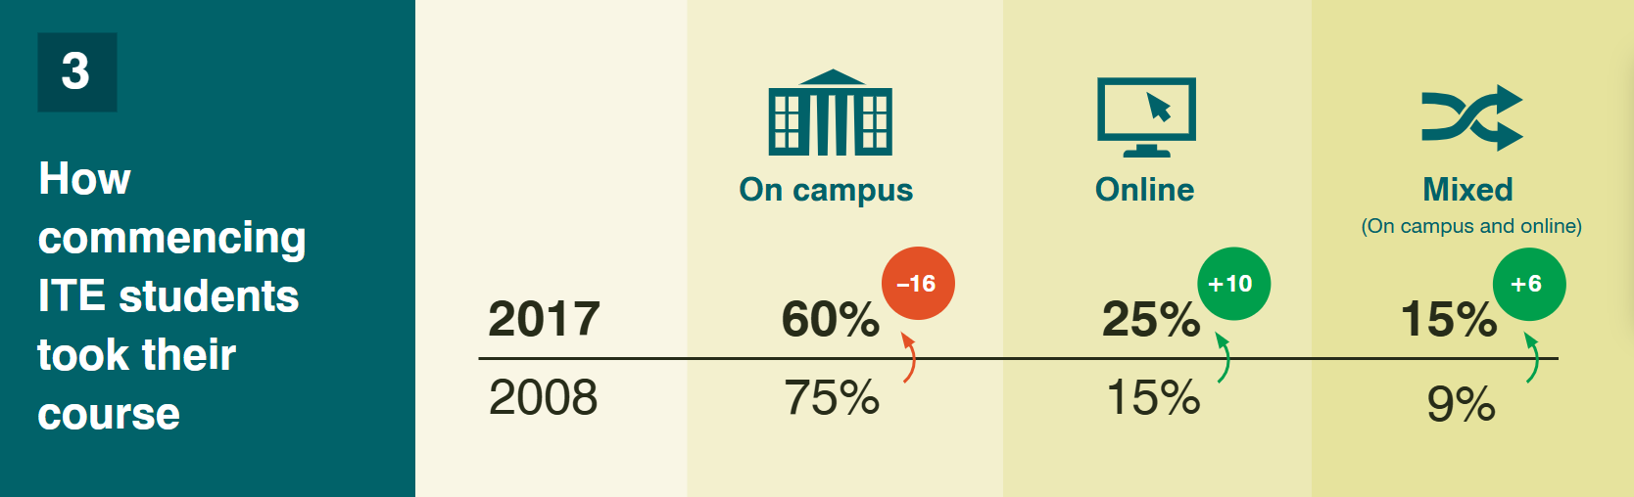

Slide 19
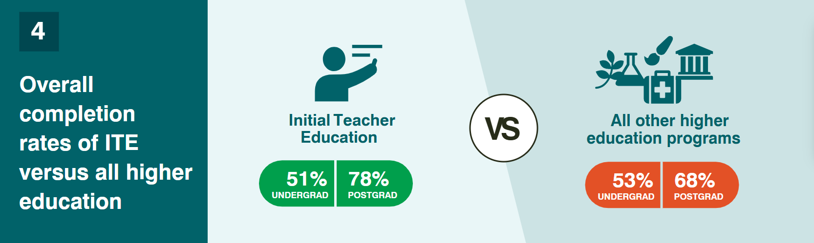

Slide 20
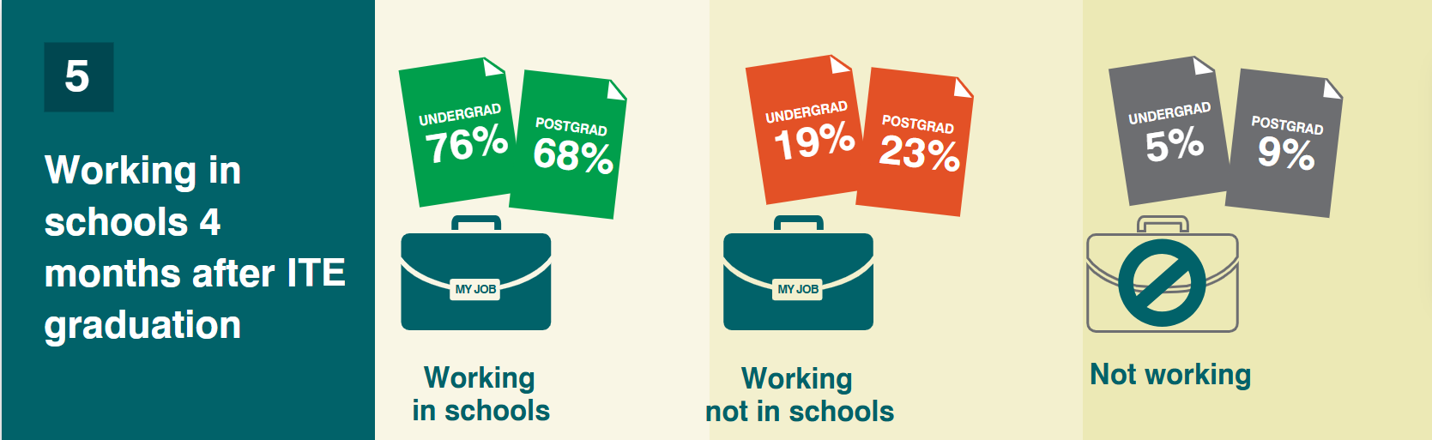

Slide 21
In practice we …
Transform Knowledge and Evidence
Communicate with intent to selected audience
Advocate for the long term use of professional groups as change agents
Build partnerships and collaborations
Encourage general and targeted behavioural change
Enable and support implementation
Notes:
support the best use of available evidence;
disseminate relevant and critical information;
develop informed policy and establish effective research initiatives and workforce development.

Slide 22
Enablers of change
Congruence and consistency
Support for disruption and consolidation
Narrative of change
Robust and real time data and adjustment

Slide 23
Putting It into Practice: What Have We Learnt?
Social and Emotional Wellbeing and Learning Can Be Challenging to Teach
Providing Content Is not Enough
There Is Critical Difference Between Being Supportive in Principle And Taking Action
Cross-Disciplinary Change Is Challenging—It Needs a Common Ground
Educators Can Learn About and Champion Mental Health and Wellbeing
Graduates not Experts—Working Towards Master

Slide 24
Take home message
There is sufficient research, policy, professional, and public support for the proposition that social and emotional wellbeing and learning in central to the work of teachers that there remains no question of whether student wellbeing should be a key element of the role of the teaching profession.
The only remaining questions are about how best to represent and support this key element of professional practice, through elements such as professional standards, initial training, teacher registration, and ongoing professional learning.

Slide 25
Every idea for moving forward should be tested against two simple questions: “Is it good for kids?” and “Will it help the health and well-being of the child and her/his family?”
Source: With Our Best future in Mind
The central question is not: “what about the students is causing the performance discrepancy?” but “what about the interactions of the curriculum, instruction, learners and learning environment should be altered so that the students will learn?”
Source: Ken Howell

Slide 26

Instructional Design
Case study: CHILD Framework

Slide 27
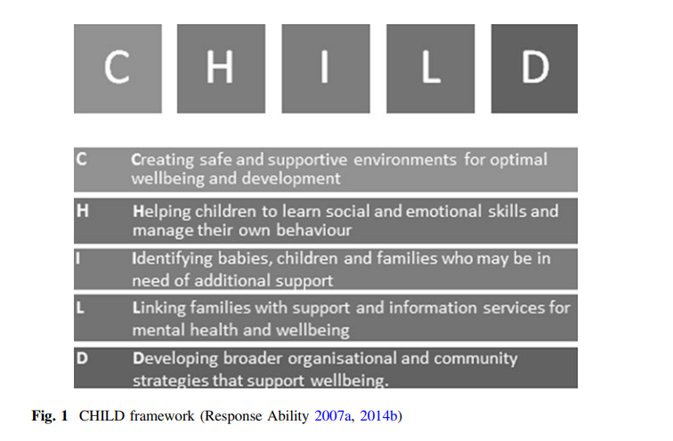

Slide 28
CHILD – Linking principles and practice
CHILD provides a heuristic for both pre-service curriculum planning and in-service professional practice.
Links health and educational promotional principles with professional practice
Notes:
This can be a point in which the connection can be made with the broader health promotion concepts and education promotion concepts.
The core ideas relate to intervention, strengthen capability, development, long and short term effects, knowledge transition, empowerment and the role of professional in supporting practice/behaviour which enables the individual/group.

Slide 29
CHILD – Linking disciplines, dimensions and doctrines
Multidimensional
Sequential or Simultaneous
Core or Elective
Generic or Applied
Multimodal
Direct Instruction
Guided/Supported Learning
Rehearsal
Problem solving
Experiential
Notes:
CHILD provide multiple points of access and connection with pre-service programs. It offers the opportunity to select from different modes, drawn of different discipline/content foundations and different instructional modes
It is “suggestive” of themes, sequences and assessment options without having a “compliance” oreintation that demands a particular sequence

Slide 30
CHILD – Linking disciplines, dimensions and doctrines
Multidiscipline
Health
Development
Cognition/Learning
Professional practice
Pedagogy
Thematic and Issue specific content

Slide 31
CHILD - Instructional Design
Multi-media
Matrix design for content/pedagogy mapping
Themes
Outcome based

Slide 32
CHILD – Adaptability and Customisation
The CHILD framework, in combination with stimulus films, documentation, and large Response Ability resources, provides lecturers with the prerequisite variety and freedom to customise instructional approaches to suite specific site/ program needs
Notes:
The resource offers lectures :”worked examples” of how activities, questions and content can be combined with the stimulus material to explore SEW. This not only empowers the lecturer’s to make choices and changes to the suggested it activities – it also demonstrates DEW in endemic to teaching and learning. This should encourage lecturer's to examine their existing approaches/content for further opportunities to foreground SEW as part of the work of teachers in supporting learning, development and wellbeing.

Slide 33
CHILD – Scaffolding and Support
CHILD framework supports lectures in linking their professional/discipline knowledge base with SEW.
Notes:
CHILD provides both a scaffold to support lecturer's examination of SDEW and a lens through which they can examine their own discipline/content areas to locate where SEW is either part of their existing curriculum deisgn or alternative where there may be opportunities to strengthen this element of teacher pre-service training.

Slide 34
Supporting knowledge in action and use
Source:
Green LW, Ottoson JM, García C, Hiatt RA, Roditis ML. Diffusion theory and knowledge dissemination, utilization and integration. Front Public Health Serv Syst Res. 2014;3(1):3. PMID: 26251771; PMCID: PMC4524659.

Slide 35
Influences on knowledge use
Source:
  Credibility
  Relationship building with potential users
  Realistic expectations of use
  Building in a consideration of use into early stages of research and development

Slide 36
Influences on knowledge use
Content:
  Accessibility
  Adaptability
  Compatibility with values, concerns, expectations or policy agenda
  Challenge the status quo
  Quality, trustworthiness and soundness
  Emphasis on positive behaviour with clear, low-cost, action implications

Slide 37
Influences on knowledge use
Medium through which knowledge is connected to user:
  Multiple sources or forms for exchange
  Intermediary linking mechanisms
  Concern for equity
  Personal interaction
  Timeliness
  Communicating language

Slide 38
Influences on knowledge use
Facilitators of use:
  Early and sustained involvement of the users
  Readiness to change
  Links among users
  Level of acquisition effort
  Interests and ideology

Slide 39
Influences on knowledge use
Context:
  Resources
  Supportive social conditions
  A champion for new knowledge
  Slack for change
  No strong political or bureaucratic opposition
  Incentives for change
  Leadership by example
  Support for long term interactive relationships

Slide 40
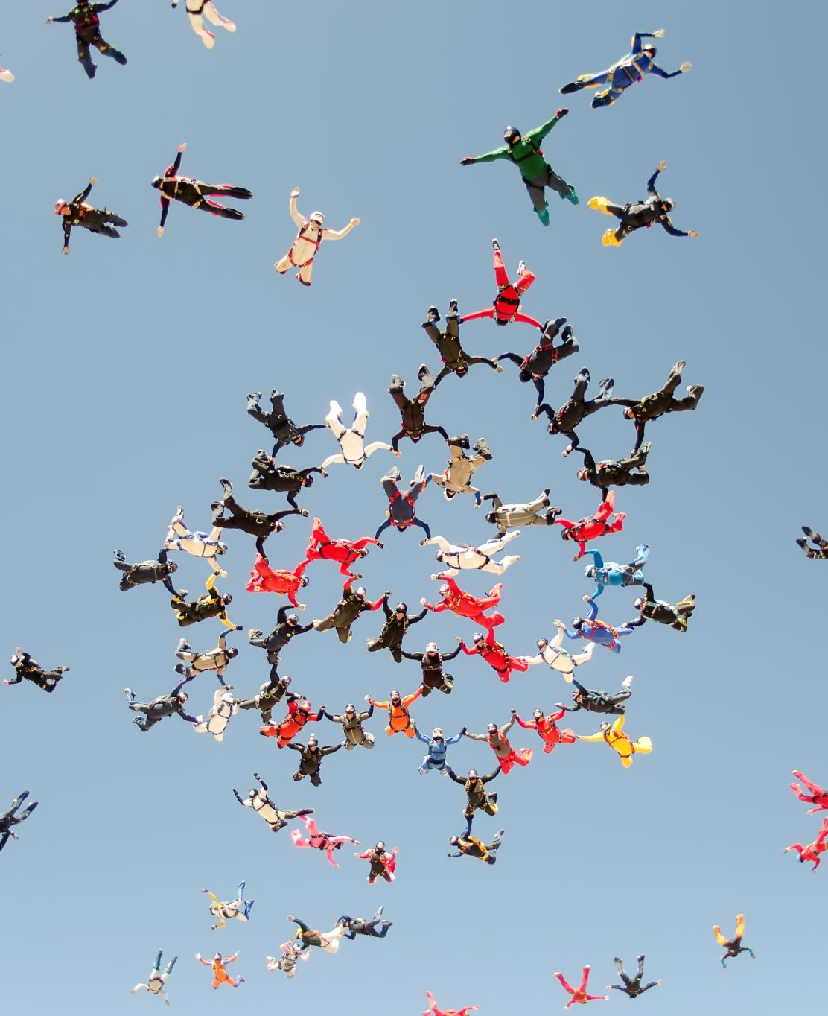
Congruence
Between evidence and practice
Between practice and principles
Between messages and objectives
Between attitudes and behaviours

