Slide 1


Building Safe School Environments: Preventive Strategies and Evidence-Based Approaches
Presentation at the Expert Strategic Meeting: Systemic Solutions in Mental Health Support and Safe School Environments
Brian Daly, PhD
Professor and Department Head
Department of Psychological and Brain Sciences
Drexel University

Slide 2

Defining the (Complex) Problem
Fact: The prevalence of school violence has decreased in recent decades (Eaton et al., 2012)
Another Fact: Youth violence in the school setting is considered a major public health issue, given its negative impact on youths’ physical and psychosocial well-being.
Notes:
In the following slides, let’s look at the complicated picture of school violence in charts.

Slide 3
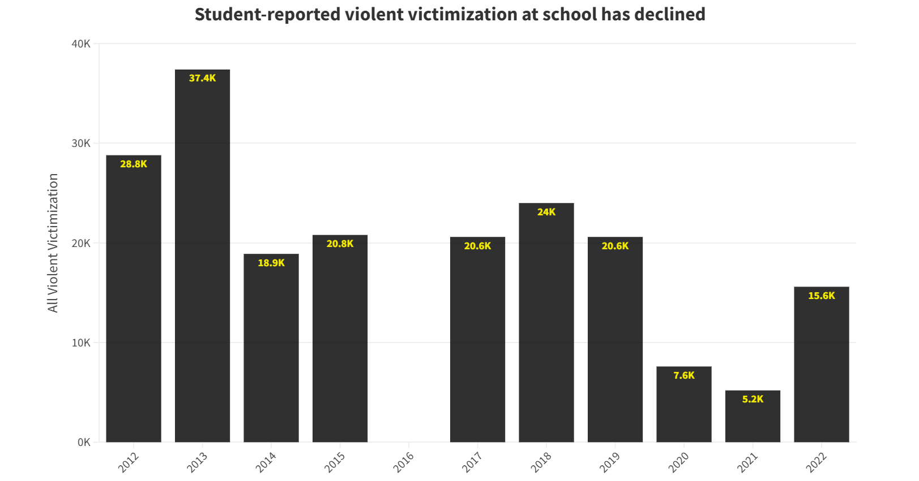

Slide 4
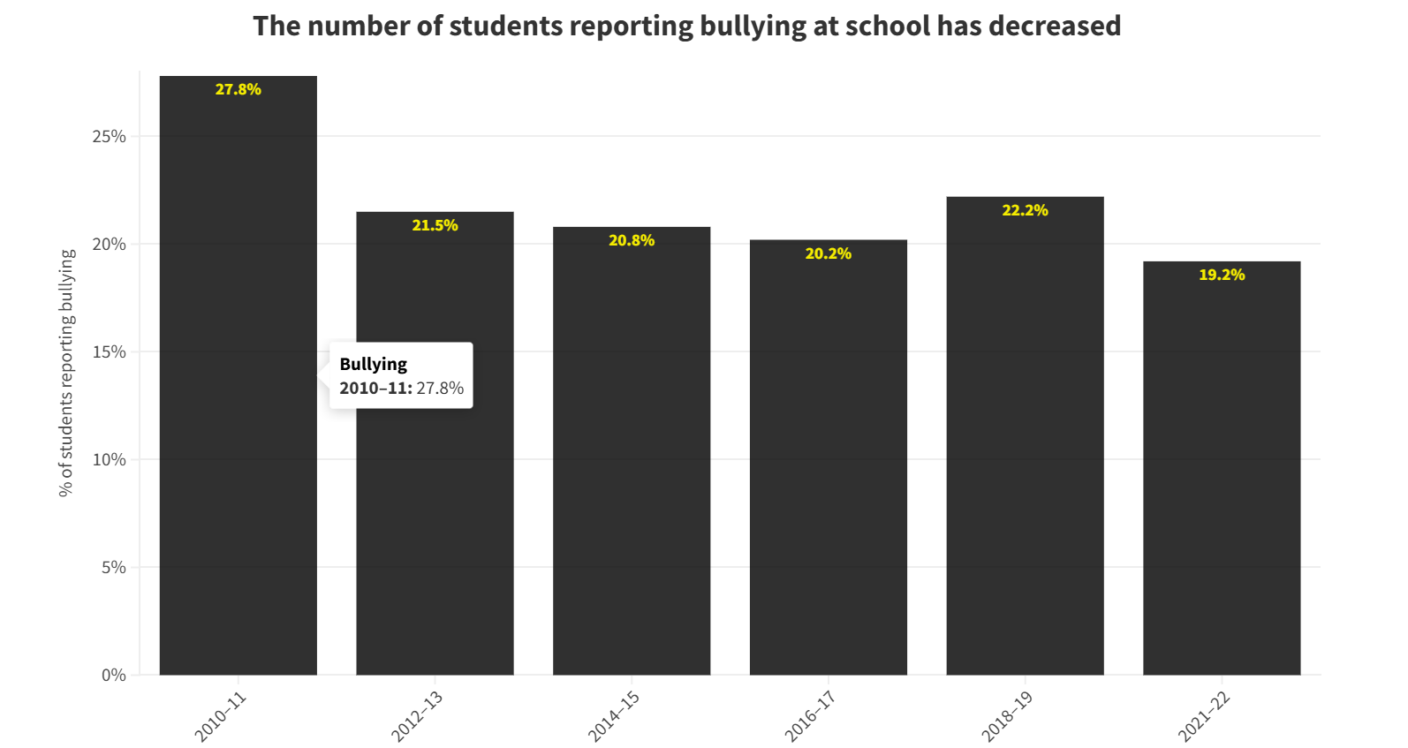

Slide 5
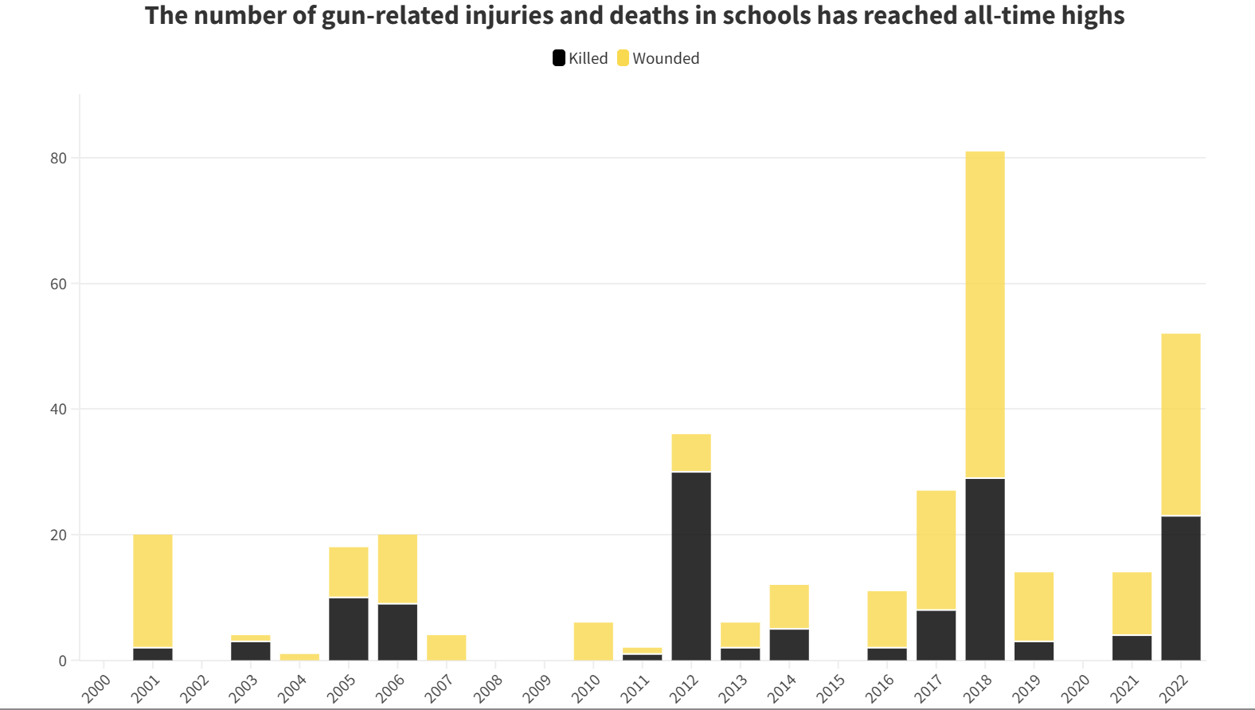

Slide 6
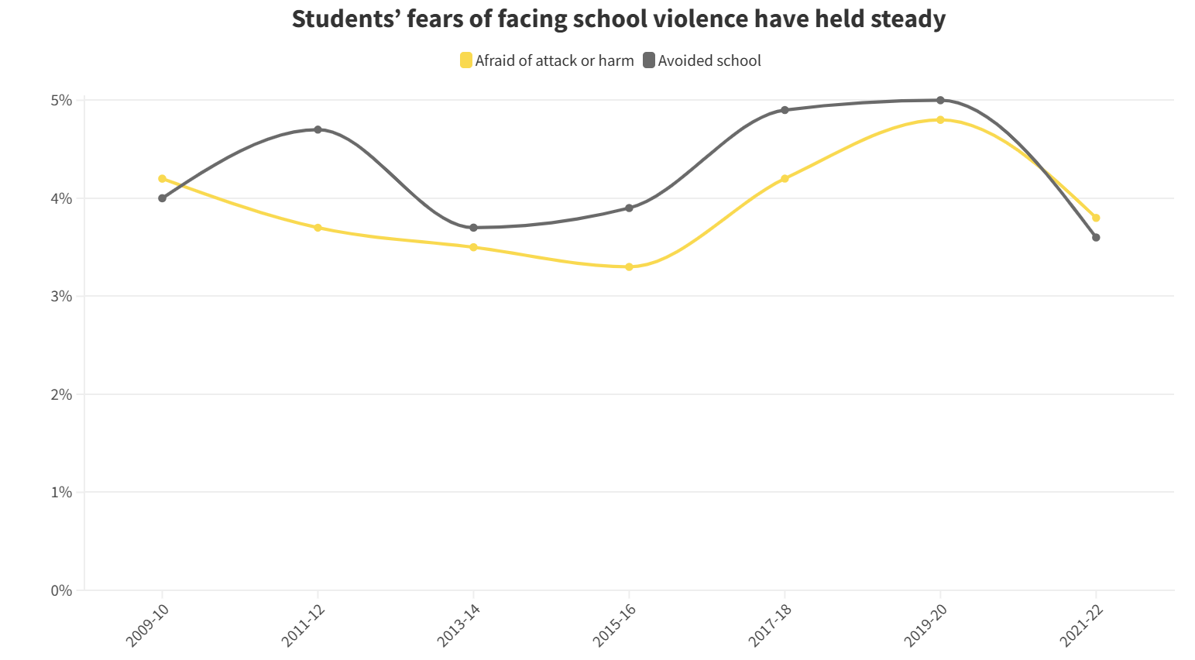

Slide 7

Defining the (Complex) Problem
How best to address youth violence in schools extends to groups (educators, administrators, caregivers, health professionals), systems (schools, criminal justice), and the larger community.
All of these stakeholders have grappled with the complex challenges around developing strategies to reduce school violence.
Notes:
In the following slides, let’s look at the complicated picture of school violence in charts.

Slide 8
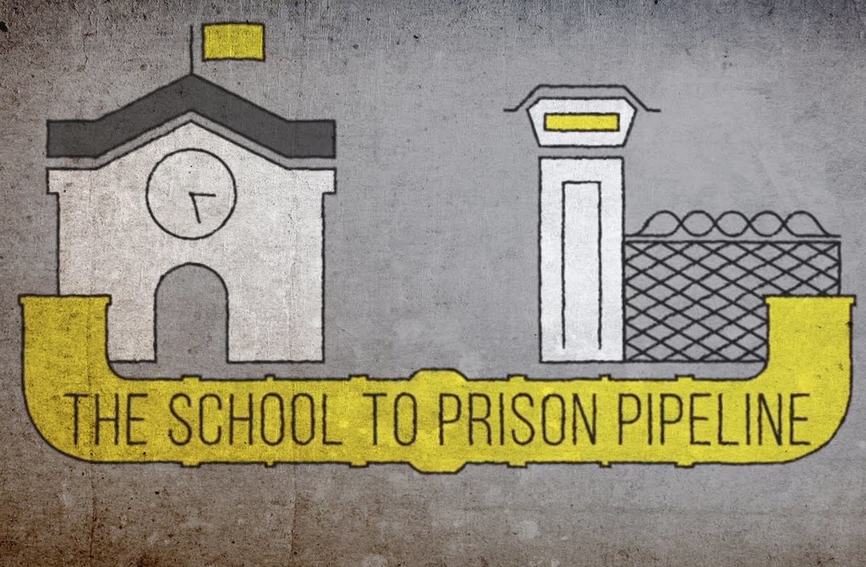
Historical Context – Zero Tolerance
In the US, a school disciplinary approach known as zero tolerance, aimed at preventing violence and other misconduct, gained momentum in the mid- to late 1990s and was used by many schools across the country.
“the application of pre-determined consequences, most often severe and punitive in nature, that are intended to be applied regardless of the gravity of behavior, mitigating circumstances, or situational context” (APA Zero Tolerance Task Force, 2008, p. 852).
Common outcomes from the policy included long-term suspensions, expulsions, and ultimately involvement with the juvenile justice system.
The “school to prison pipeline”

Slide 9

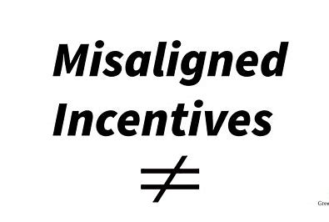
Zero Tolerance – Misaligned Incentives?
“War on drugs”
Gun Free Schools act (financial incentives for zero tolerance policies)
No Child Left Behind (financial incentives for academic performance)
Safe Schools/Health Start Initiative
Notes:
For NCLB, the incentive was to expel the lower performing students to improve the overall academic performance of the school – to get more financial incentives.

Slide 10
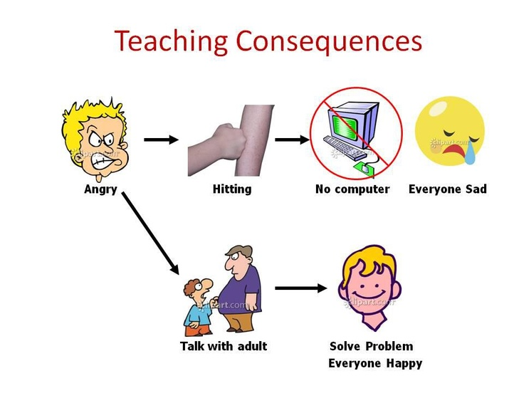
Zero Tolerance – Consequences
Approximately 3 million students were suspended out of school, 108,000 students were expelled, and more than 240,000 students were referred to law enforcement (years 2009-2010).
Several of the assumptions underlying zero tolerance never received empirical support.
Biggest assumption: providing consequences to students with disruptive behavior will deter these students from engaging in similar conduct in the future.
Seems reasonable, right?

Slide 11
Complex Problems and Complex Solutions
Better assumption: Detering disruptive behavior requires multipronged, systemic, and sustained efforts by students, parents, teachers, administrators, communities, and society.
What doesn’t work (well)?
Use of metal detectors or other security measures
Youth mentoring and anti-truancy programs (promising but findings are uneven)
Notes:
He found that there was no significant correlation between a school’s financial investment into safety programs (security guards, metal detectors, cameras, etc.) and a school’s level of violence (Bryan, 2009).

Slide 12
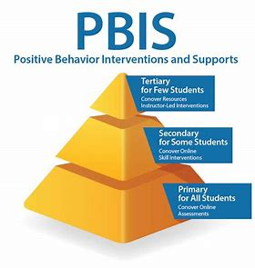
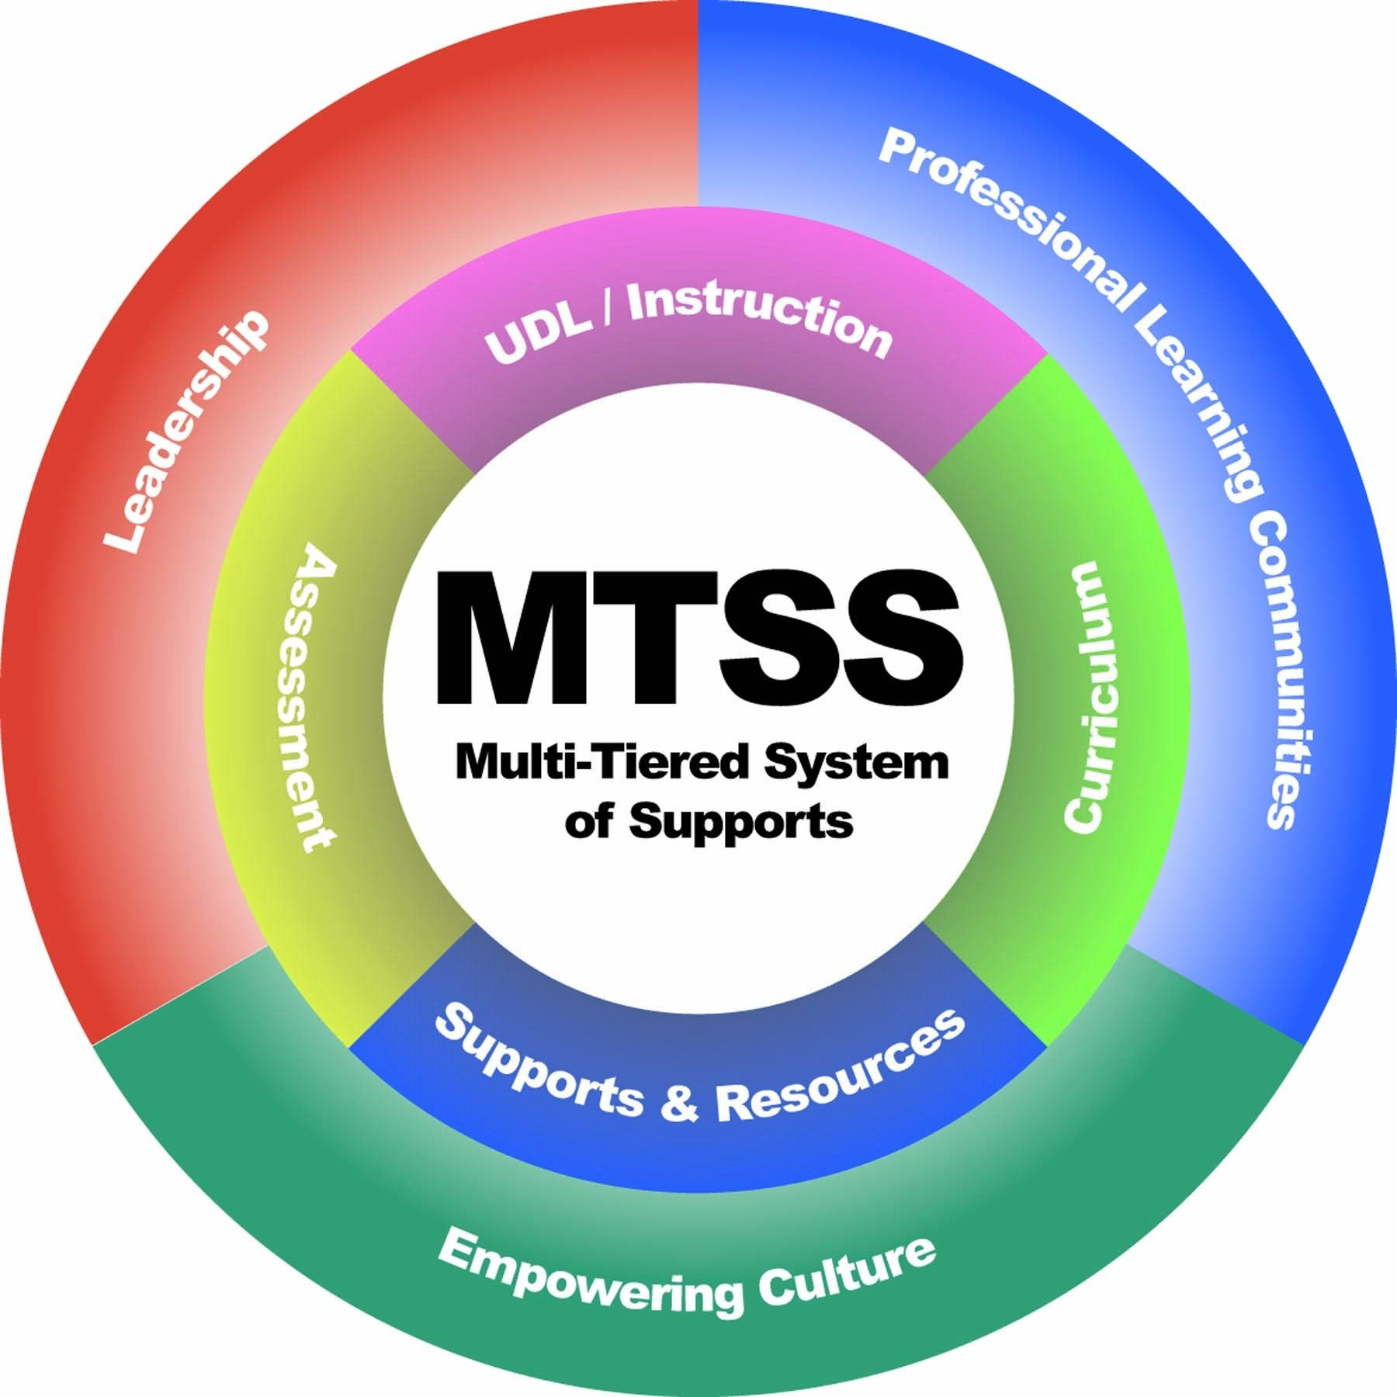
What does work?
Schoolwide Disciplinary Strategies (graduated)
Schoolwide Disciplinary Approaches (PBIS)
Violence Prevention Programs
Restorative Justice Programs
Student Mental Health and School Climate (MTSS)

Slide 13
Schoolwide Disciplinary Strategies
Graduated schoolwide positive disciplinary approach that emphasizes keeping youth in school rather than pushing them out.
Policy changes to revise codes of discipline; policies emphasize responsivity to individual students’ needs, introduction of schoolwide prevention and intervention programming, or both.
Strategies to improve school climate include increased teacher training for managing student behavior, a collaborative problem-solving approach to school safety, and early warning systems that identify students in need of behavioral support.

Slide 14
Schoolwide Disciplinary Approach
Positive Behavior Interventions and Support: a comprehensive, multitiered universal prevention and intervention program that focuses on providing behavioral support to students and consultation support to teachers.
PBIS is effective in decreasing rates of office referrals, suspensions, and expulsions and improving student ratings of school climate.
Children in schools with PBIS systems are 33% less likely to receive an office discipline referral than are children in comparison schools.

Slide 15
Violence Prevention Programs (VPP)
VPP seek to remediate risk factors associated with youth violence (poor decision making, lack of empathy, negative attitudes about self and others), and address bullying, aggressive classroom behavior, weapon carrying, or organized gang activity.
The Second Step program (ages 5–12 years) is delivered in classrooms and focuses on reducing impulsive and aggressive behaviors by promoting self-reflection, emotional awareness, and problem-solving skills.
The Providing Alternative Thinking Strategies program is a classroom-based intervention (ages 5–11 years) that promotes social and emotional competence while also reducing behavior problems.

Slide 16



Slide 17
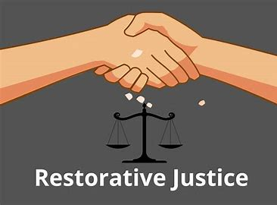
Restorative Justice Programs (RJ)
An approach to addressing conflict and misconduct that focuses on healing rather than punishment and engages those directly affected in addressing the misconduct.
RJ assumes that misconduct and conflict injure those directly involved (victims and offenders) as well as the broader community to which they belong.
Rather than relying on punishment, RJ expects those who cause injuries to make things right with those they’ve harmed and with their community.

Slide 18
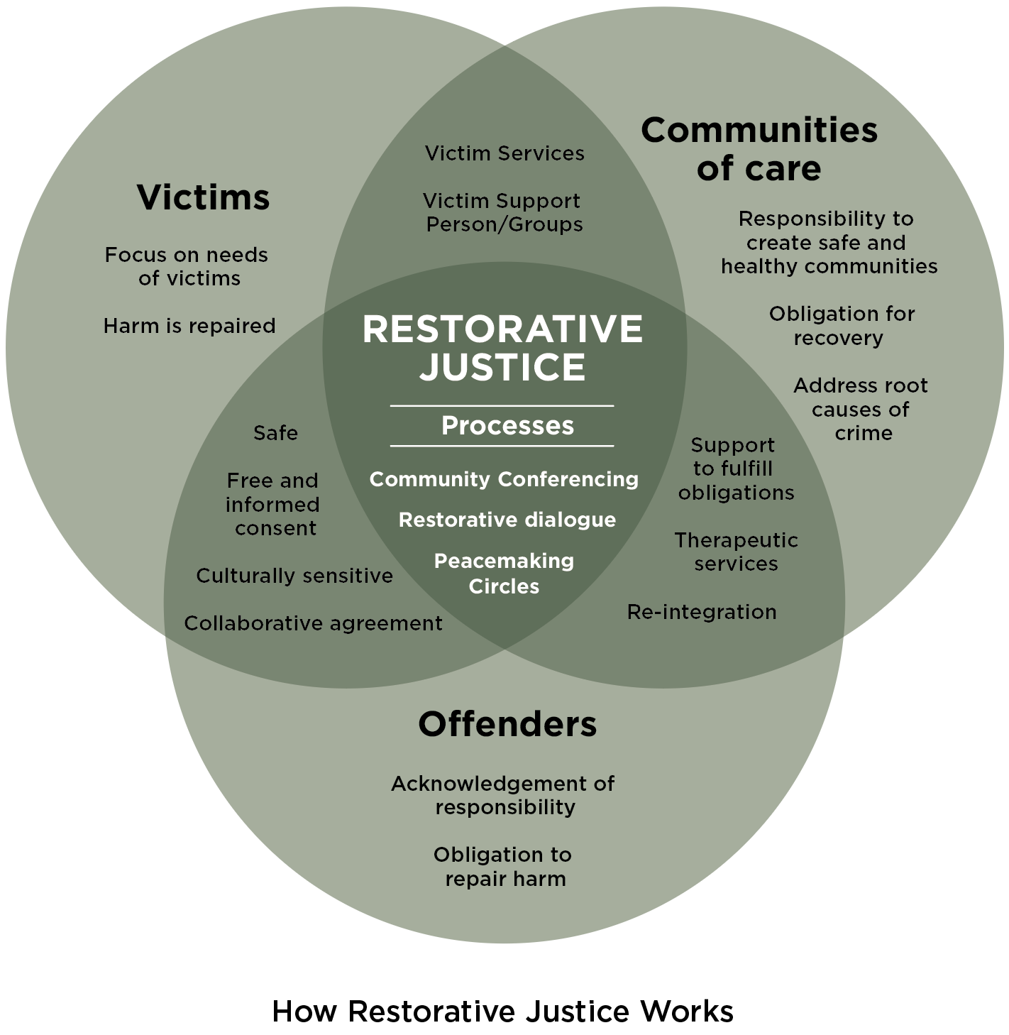

Slide 19
Restorative Justice Programs (RJ)
Traditional Discipline Asks
Restorative Justice Asks
What rules have been broken?
Who did it?
What do they deserve?
Who has been hurt?
What are their needs?
Who has the responsibility to make things right to restore relationships?

Slide 20
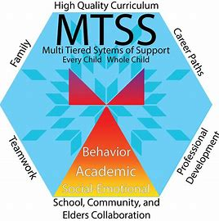
Student Mental Health and School Climate
Strengths-based approaches
Collaboration with students and families
Integration into multi-tiered systems of support (MTSS)
-incorporate data-based decision making
-evidence-based practices
-ongoing evaluation and quality improvement efforts

Slide 21
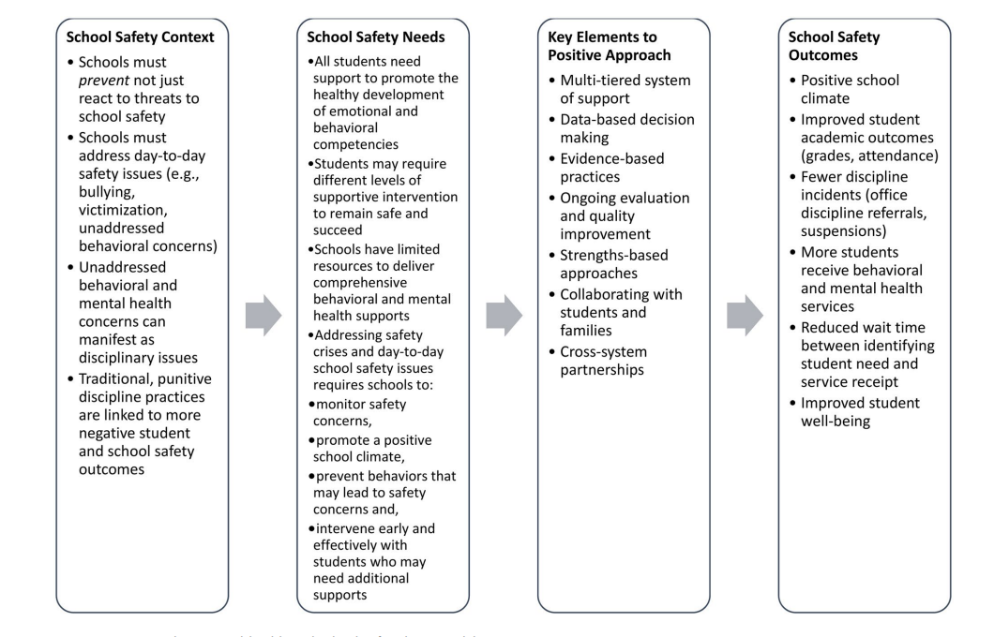

Slide 22

Resources
Evidence-based practices
The Evidence-Based Practices Resource Center hosted by the Substance Abuse and Mental Health Services Administration (https://www.samhsa. gov/ebp-resource-center)
SHAPE resource center hosted by the National Center for School Mental Health (https://www.theshapesystem.com/)
Center for the Study and Prevention of Violence (https://cspv.colorado.edu/)

Slide 23
Resources
Evidence-based practices
Blueprints for Healthy Youth Development (www.blueprintsprograms.org)
Restorative Justice Council (www.resorativejustice.org.uk)

Slide 24


THANK YOU

