Slide 1

Mark Weist & Brian Daly, Prague – April 28, 2025 see https://smhile.org

Slide 2

Outline
Brief history of SMHILE
School Mental Health – Critical Themes
The Importance of Relationships
Elevating Student and Family Leadership
Key International Themes

Slide 3

SMHILE Leadership in International Meetings
Past Meetings
Planned Meetings
London, 2014
Columbia, SC 2015
Banff, 2017
Poland, 2017
Sweden, 2018
Washington, DC 2019
New Zealand (virtual), 2021-2022
Utrecht, Netherlands, 2024
Barcelona, March 2025 (Holistic School Behavioral Health, SBH)
Prague, April-May 2025 (Supporting the Czech Republic in Growing SBH)
Oahu, Hawaii, June-July 2025 (Pacific Region Forum on SBH and Disabilities)
Toronto, June, 2026 (Global Leadership Exchange https://gle.world)

Slide 4
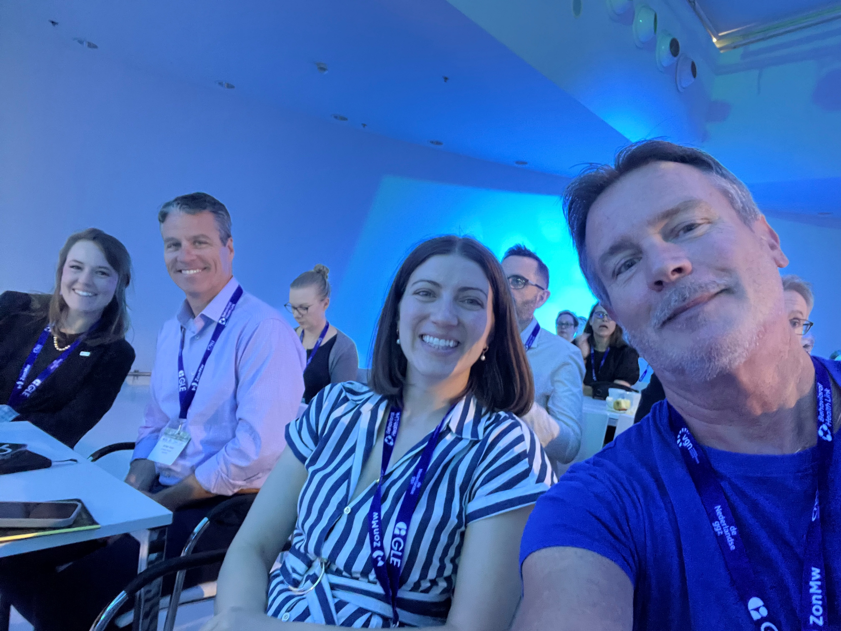
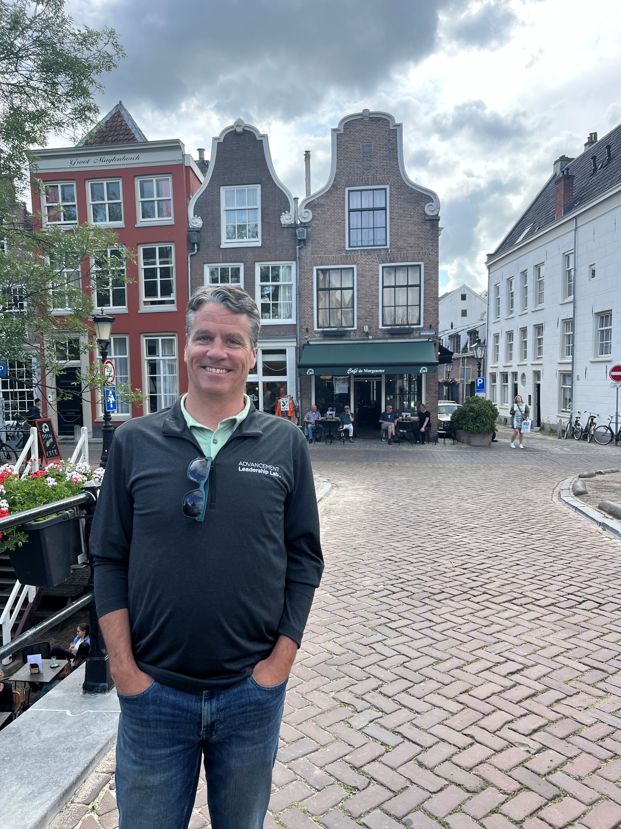
June, 2025 Utrecht, the Netherlands

Slide 5
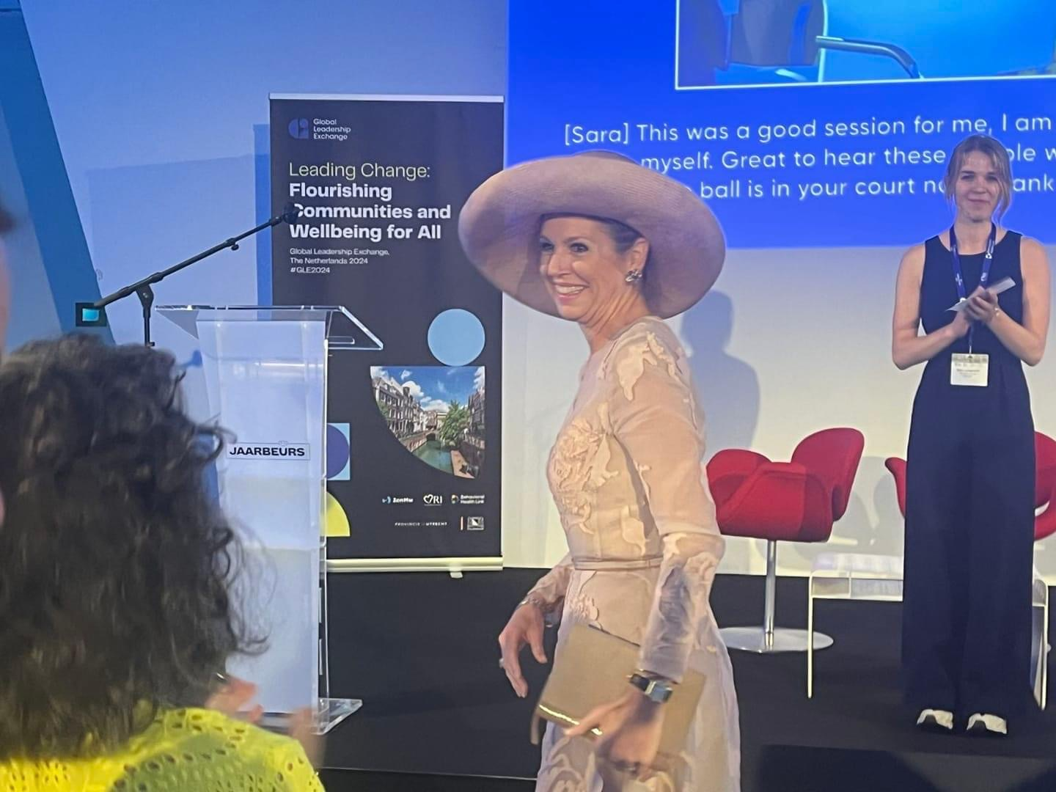
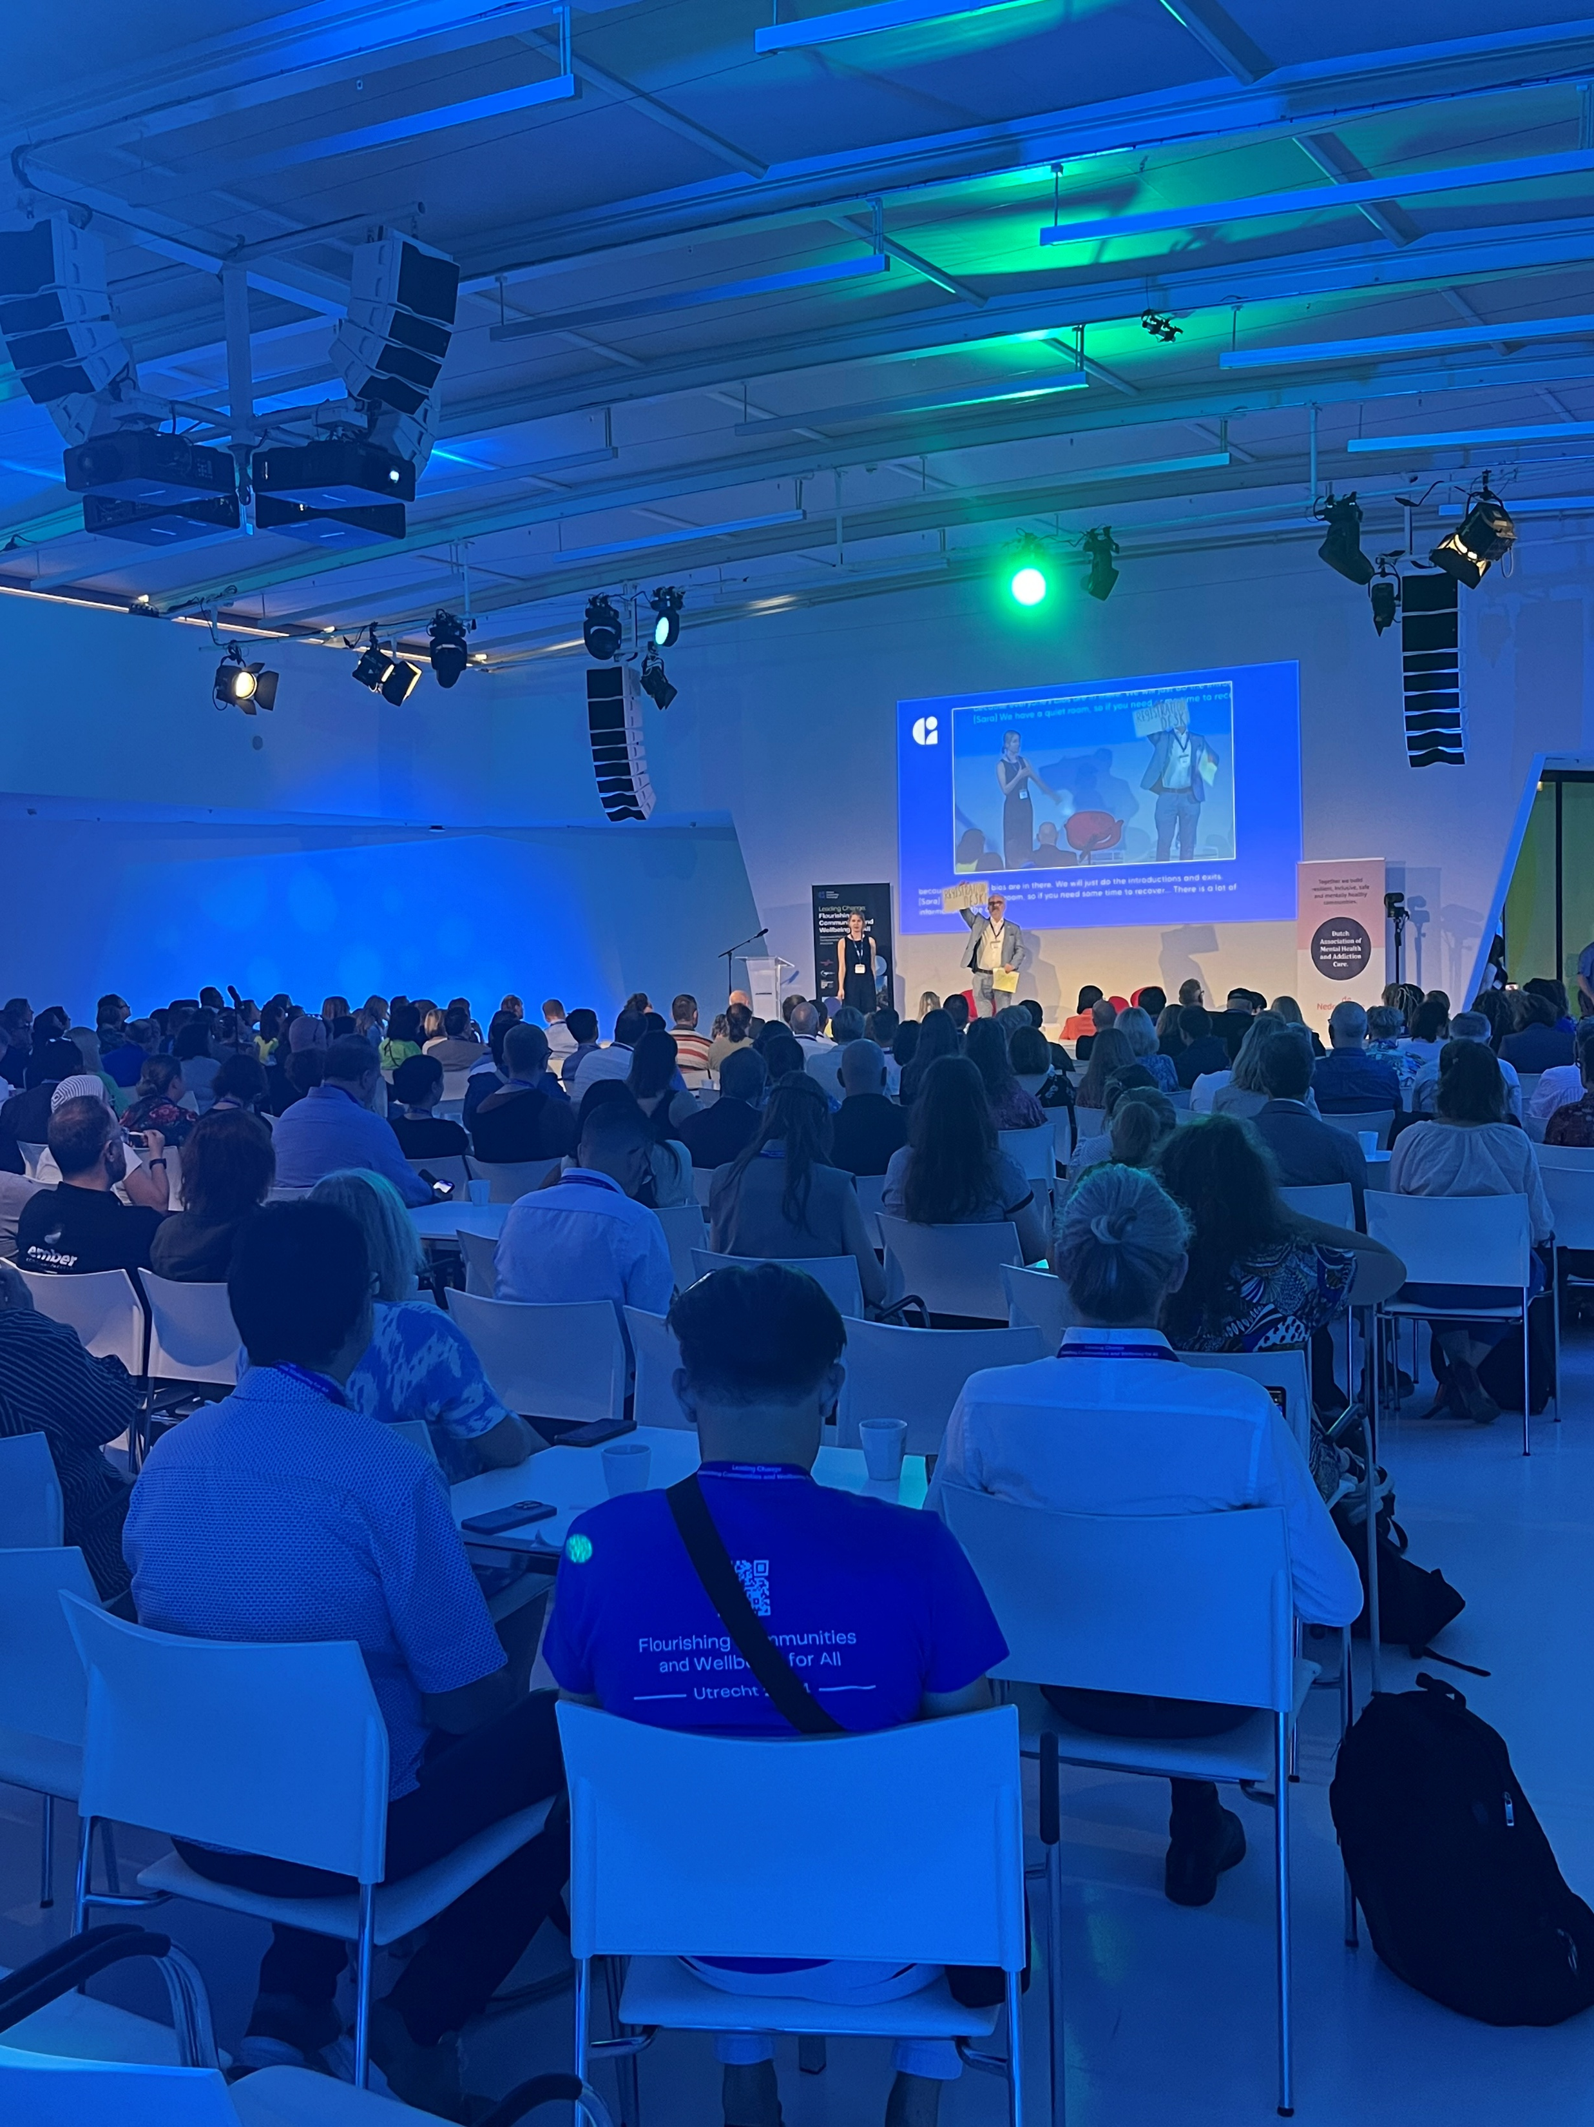
Utrecht cont.

Slide 6



Integrating the fields of pbis and school mental health

Slide 7

Maternal and Child Health Bureau/Health Resources and Services Administration
Mental Health in Schools Initiative, 1995
Two National Centers
  University of Maryland School of Medicine
  University of California, Los Angeles
Five States
  Kentucky, Maine, Minnesota, New Mexico, South Carolina
Initial leadership by project officers Juanita Cunningham Evans, and Dr. Michael Fishman

Slide 8
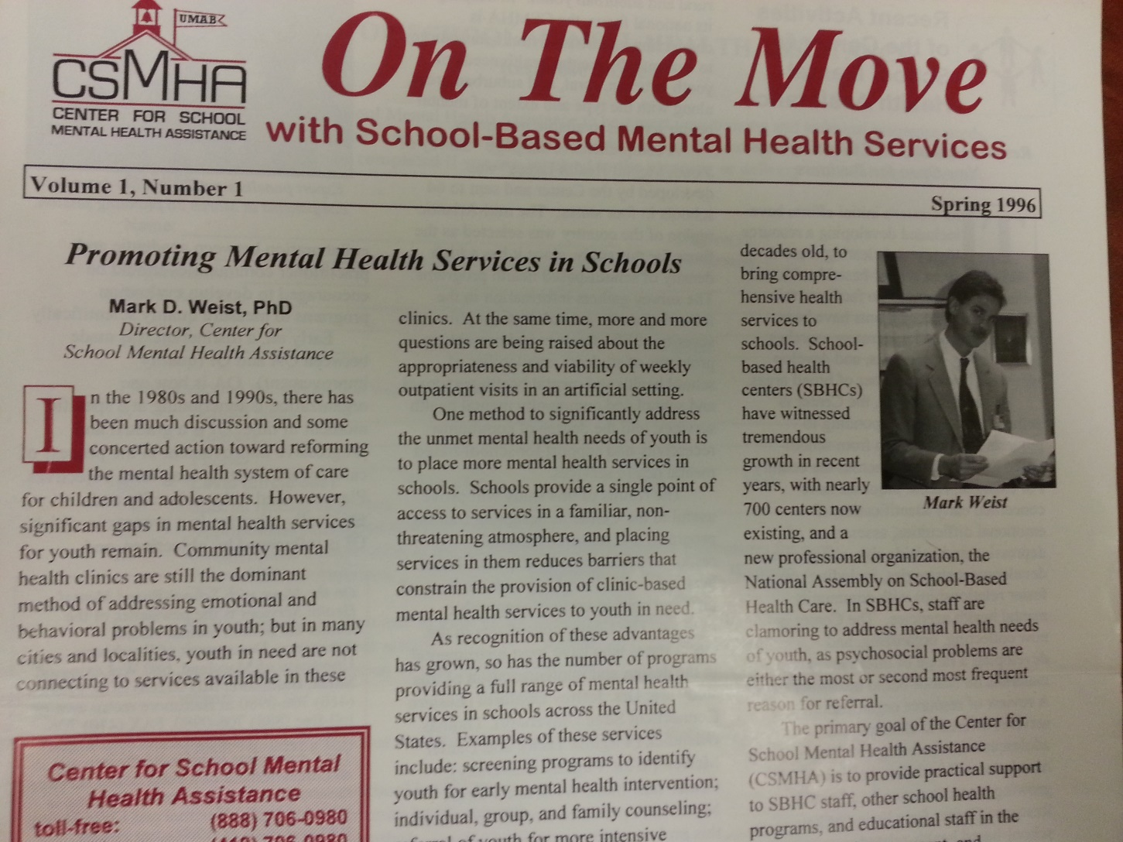
Center for School Mental Health Assistance, 1996

Slide 9
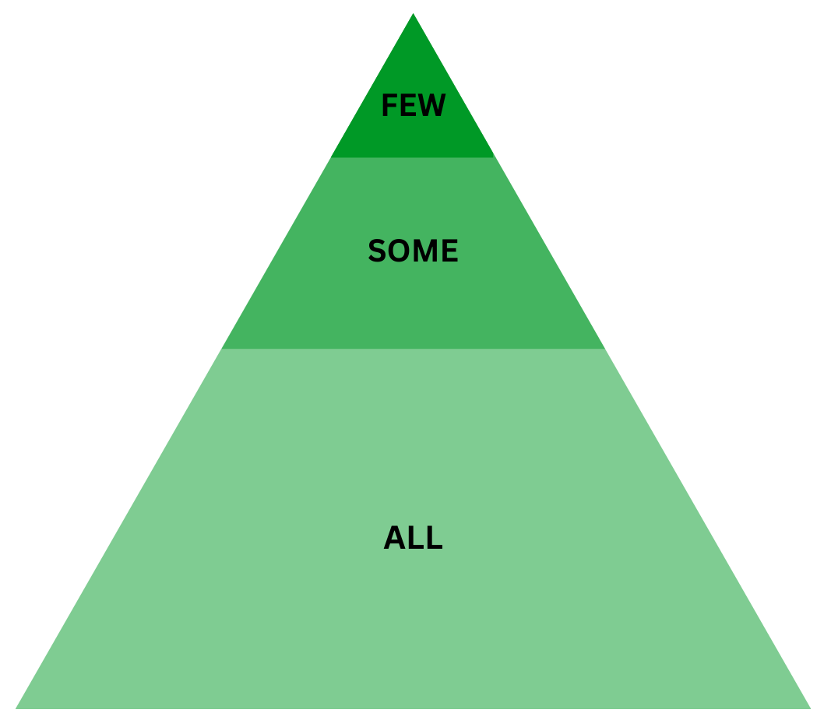
Positive Behavioral Interventions & Supports (PBIS)
Multi-tiered framework for supporting students' social, emotional, behavioral, and academic development
Continuum of support
  Tier 1: universal practices that support ALL​
  Tier 2: targeted supports for SOME students​
  Tier 3: intensive and individualized supports for FEW students
www.pbis.org

Slide 10

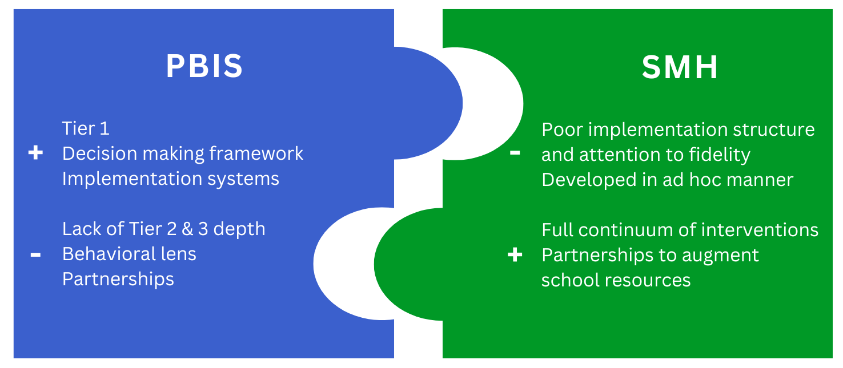

Interconnected Systems Framework (ISF)
One cohesive framework integrating education and mental health systems
Enhances depth and quality of prevention and intervention
Barrett et al., 2013; Eber et al., 2020

Slide 11
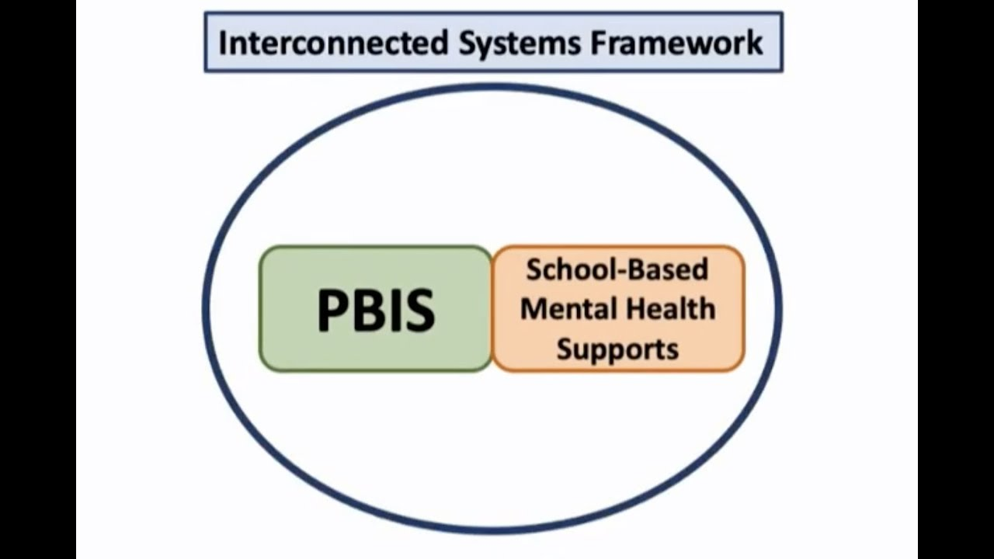
ISF – Core Processes
Data-based Decision Making
  School data (beyond discipline), community data
EBP Selection, Implementation, and Refinement
  Behavior, social-emotional skills, and mental health
Screening and Progress Monitoring
  Internalizing and externalizing concerns
  Fidelity and effectiveness
Implementation Support
  Coaching across levels, including aligning programs across tiers

Slide 12

Critical Role of School Teams
Perhaps the best indicator of overall MTSS quality and impact
Meetings should be consistently and systematically (e.g., using Team-Initiated Problem Solving) conducted
Should include the right members (administration, teachers, mental health staff from the school and community, families and students)

Slide 13
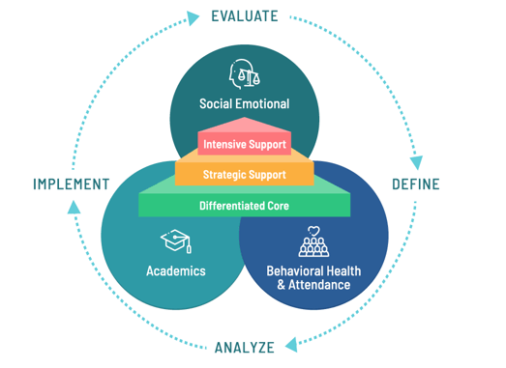
Critical Role of School Teams
Need to map existing teams and their effectiveness and move toward one very well-functioning MTSS team focusing on SEBMH (meeting at least twice monthly, with team leaders assigned to each of the three tiers and having sub-conversations)*
Community MH staff should be on this lead MTSS team and should be treated/viewed as if they are school employees
*Mark’s opinion

Slide 14
Current Teams
Doing Great work, but….
District Equity Team
SEL Team
District PBIS Leadership Team
Mental Health
Climate and Culture Workgroup
Superintendent and Admin
UDL
Teaching and Learning
Midtown Community Partners
Restorative Practices
District Whole Child Committee
District MTSS Leadership Team
Suicide Prevention Planning Team
Threat Assessment
Safety Committee
Inclusion Committee
District Discipline Team
Attendance Team

Slide 15


Slide 16
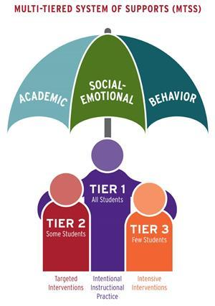
Impact of Systematic Social-Emotional-Behavioral Screening
Splett et al., (2018). Comparison of Universal Mental Health Screening to students already receiving intervention in a multitiered system of support. Behavioral Disorders, 43(3), 344-356. https://doi.org/10.1177/0198742918761339

Slide 17


Some notes on relationships

Slide 18

All Roads Lead to Social Connection and Unconditional Belonging
Connection is the strongest protective factor against trauma and toxic stressors

Slide 19
What does health and wellness look like in schools and classrooms?
Every child known
Clearly defined expectations, routines, procedures co-developed with peers and adults
Explicit instruction of expectations, routines and procedures with opportunities to practice
Routines for checking in with students
Clearly defined ways to ask for help
Movement and free play
Healthy food

Slide 20
Health and Wellness Practices in the Classroom
Door Greetings
Morning Meeting/Community Builder
Explicit Instruction
Predictability through Routines and Procedures
Behavior Specific Praise (5:1)
Active Supervision
Physical Arrangements
Press Pause
Box Breathing
Movement/Play

Slide 21
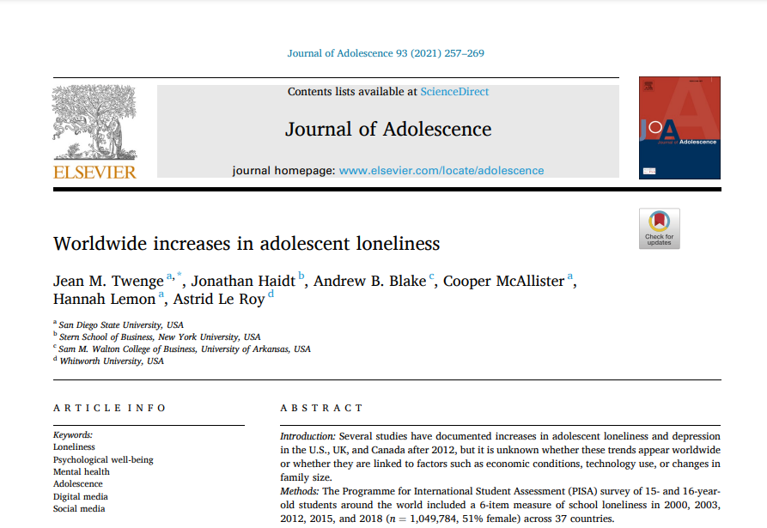

Slide 22
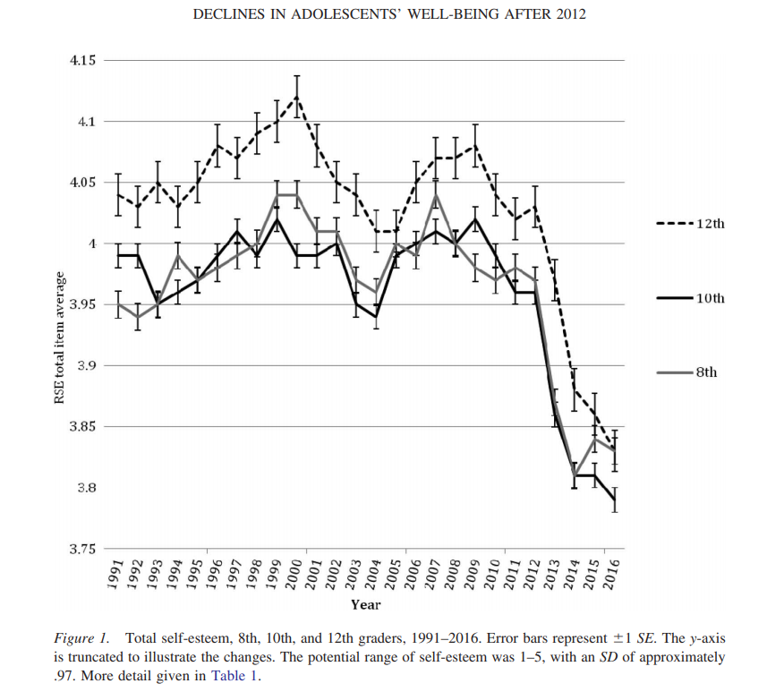

The Plight of Modern Adolescence
Twenge, et al. (2018)

Slide 23
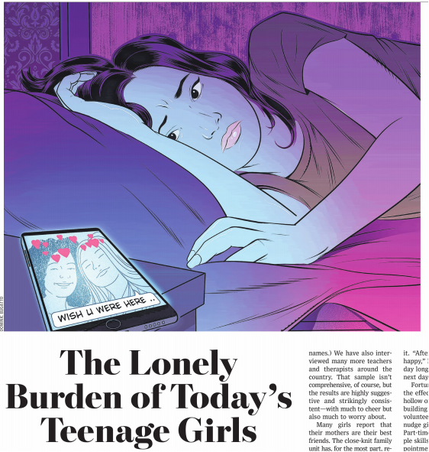
Pipher & Gilliam (2019)
Notes:
WSJ Mary Pipher and Sarah Pipher Gilliam

Slide 24

Relationships matter
Relationships are part of our “species normal environment” (Scarr, 1992)
Our brains are hardwired for relationships (Banks, 2015; Siegel, 2015)
Without relationships, our physical and mental health suffer (Murthy, 2020; Lunstad et al., 2017; Holt-Lunstad, et al 2010)
Social isolation in childhood predicts poor prognosis in adulthood (Caspi et al., 2006; Lacey, et al. 2014)

Slide 25
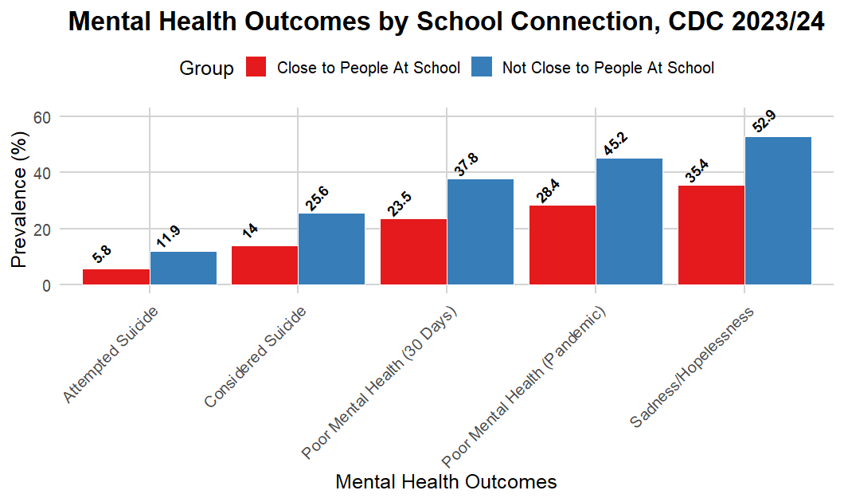

Slide 26


Relationship building behaviors
Amanda Davis, Ph.D.

Slide 27
Relationship Building Behavior Scale (Davis, 2024)
1. Told me when I did a good job on something, like worked hard
2. Encouraged me to do my best
3. Encouraged me to go after my goals
4. Talked to me about my interests outside of class time
5. Said hello to me outside of class time
6. Asked me questions about my life outside of school
7. Checked in with me about my life outside of school
8. Smiled at me
9. Greeted me by name when he/she sees me
10. Told my family when I have done something well
11. Set clear expectations
12. Let me make choices for myself
13. Spent time with me one-on-one
14. Let me know that he/she cared about me
15. Encouraged me to help them in the classroom
16. Helped me set goals for myself
17. Helped me reach my goals
18. Was willing to help me with my problems
19. Shared things about himself or herself with me
20. Said nice things to me, even when I made mistakes
21. Talked to me about my interests
22. Asked me about my family
23. Stood up for me
24. Got me the help I need when I was struggling with my emotions*
25. Talked to me about my emotions or mental health*
26. Celebrated my successes with me*
27. Noticed when I am having a hard day*
28. Acted interested in what I had to say*
29. Told funny jokes*
30. Joked around with me*
31. Asked me about my culture*

Slide 28

Lifting Youth and
Family Voice

Slide 29
Co-Creation of Spaces Together
All decisions made with students, not for students

Slide 30
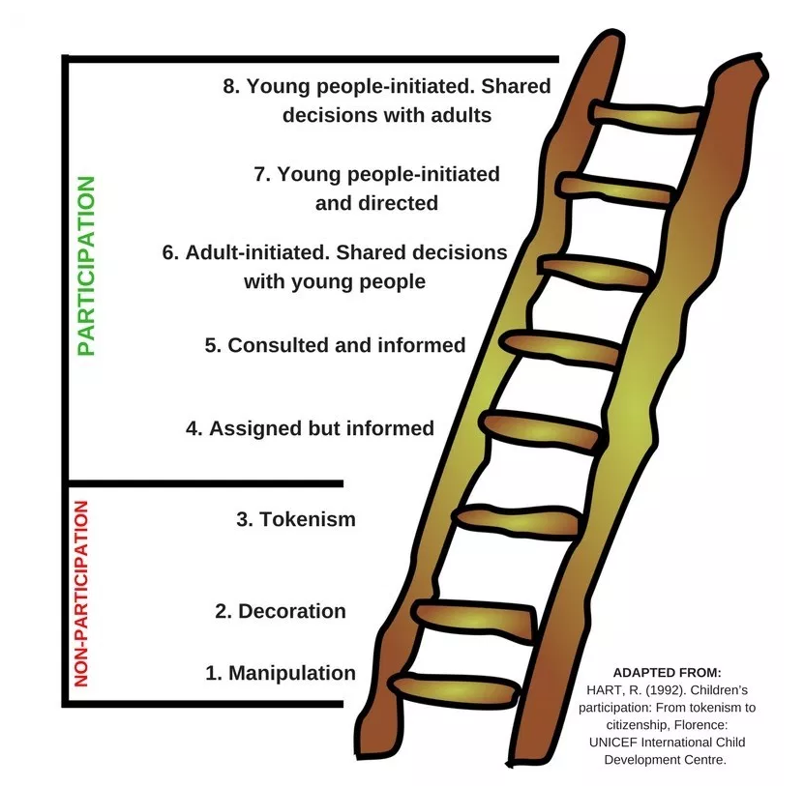
Hart’s Ladder of Youth Participation

Slide 31



Building and Scaling Effective School Mental Health Programming and Initiatives: The Importance of Global Collaboration and Leadership

Slide 32

Context Setting
School Mental Health International Leadership Exchange
SMHILE in Sweden
SMHILE in Washington
SMHILE in New Zealand
IIMHL Leadership Exchange
Perinatal and Infant, Child, Youth and Family Mental
Health and Wellbeing Supermatch
Virtual School Mental Health Match
https://smhile.org/
Notes:
Kathy talks about SMHILE and our connection to IIMHL
Kathy describes the Match, goals, structure of meeting, highlighting the importance of leaders gathering to discuss global issues in SMH

Slide 33
Key Themes for Leadership in School Mental Health
Effective leadership in times of complexity and change
Meaningful engagement with diverse stakeholders
Workforce development
Strategies to advance uptake and sustained implementation
Interconnected measurement
Collaboration across sectors and disciplines
Notes:
Consider the above in sequence: - first you set the conditions, then you consult with stakeholders, then develop workforce, then sustain, measure, and work with the wider community.

Slide 34
Effective leadership in times of complexity and change
Well-designed and comprehensive systems of supports for students and school personnel that are rooted in foundational infrastructure (teams, protocols, agreements, data systems, etc.)
Maintaining and promoting staff and personal wellbeing to meet the complexities and inevitable changes associated with school and system leadership;
Conceptual frameworks of disaster response and recovery can be applied to support leaders whose schools and local communities are impacted by a disaster, crisis, or traumatic event.

Slide 35
Meaningful engagement with diverse stakeholders
A co-design approach, informed by relevant culture(s), inclusive of all interested parties and ongoing, leading to continuously evolving responses.
Student and family voice is critical and should be prioritized.

Slide 36
Workforce development
Offer mental health literacy learning to non-specialist service providers, like teachers and guidance counselors
Prioritize ongoing professional learning for SMH professionals in evidence-based, implementation-sensitive protocols
Begin building the workforce in high school, with emphasis on attracting more diverse young people to the SMH field.

Slide 37
Strategies to advance uptake and sustained implementation
Conduct a resource mapping assessment that helps to identify existing strengths, available resources, gaps, etc., drawing on inputs from a range of stakeholders.
Select programming that is evidence-informed, implementation-sensitive, and culturally responsive.
Ensure supportive infrastructure that facilitates scalability and sustainability (e.g., requisite investments to scale, implementation teams, etc.)
SISTER project, Cook et al. 2019

Slide 38
Strategies to advance uptake and sustained implementation
Co-design and adapt interventions to context.
Offer role specific education and training that is fit for purpose. Provide ongoing coaching support.
Use evaluative and iterative strategies to refine programming and implementation supports.
SISTER project, Cook et al. 2019

Slide 39
Interconnected measurement
Measurement-based care (MBC) is the continuous collection of client-report data used to support clinical decision-making as part of standard care.
In SMH, progress monitoring is used to quantify a student’s rate of improvement or responsiveness to prevention or intervention, and to evaluate the effectiveness of interventions using valid and reliable measures.

Slide 40
Collaboration across sectors and disciplines
Cross-discipline and cross-sector collaboration is a critical component of establishing comprehensive and sustainable school mental health programming.
Members should work together to establish a unified, child-centered vision, and to develop specific operational definitions to clarify the roles and responsibilities of all members within the system.
Cross-sectoral training in common evidence-informed interventions, consistent measurement, and stepped care approaches across a single system of care can provide seamless access and support for children, youth and families.

Slide 41

The Power of International Dialogue and Collaboration
Cross-jurisdictional perspectives on core themes in SMH
Identification of common problems of practice, with platforms for sharing of enablers, innovations, and ideas
Collaborative projects and testing of innovations across regions
Strategic “borrowing” with adaptation and consultation
Global spread of best practices
Practical assistance across jurisdictions
Shared contribution to the scientific literature
Notes:
Commentary on the value of global meetings for sharing ideas, observing commonalities, hearing how others are managing emerging issues (e.g., disaster response in Aus and NZ has implications for us all as climate change increases, follow up meetings and connections).
Importance of youth voice and leadership, and two-way mentorship.

Slide 42

Thank you weist@sc.edu bpd36@drexel.edu

