Slide 1



Integrating School Mental Health and Safety Systems
Nate Thompson
Director of Social, Emotional & Behavior Services
Littleton Public Schools
Littleton, Colorado USA
nthompson@lps.k12.co.us
SMHILE / SOFA / Apr2025 / Prague, CZ

Slide 2


Times have changed. What about schools?
Then
Now
Narrow definition of success
Reactive approach to behaviors
Safety measures were an afterthought
Guidance Model
Low technology / use of data
Inclusive, whole-child focus
Proactive / PBIS / Tiers of Support
Safety is important and highly organized
Comprehensive Mental Health Model
Multiple tech tools and data sources

Slide 3
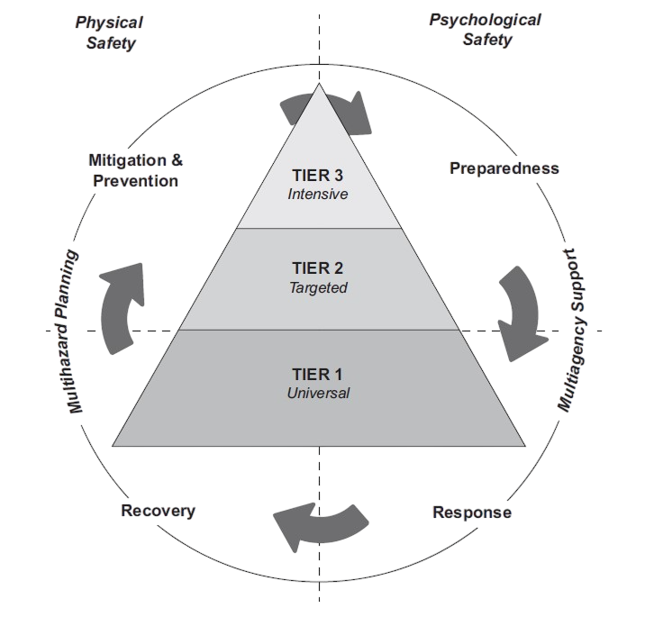

M-PHAT
Model of School Safety
Multi-Phased
Multi-Hazard
Multi-Agency
Multi-Tiered
Originally from Comprehensive Planning for Safe Learning Environments: A School Professional’s Guide to Integrating Physical and Psychological Safety – Prevention Through Recovery, by M.A. Reeves, L.M. Kanan, & A.E. Plog, 2010 New York, NY: Routledge.

Slide 4
What does an integrated model look like?
Physical
Safety
Equipment, Security Measures,
& Incident Command
Psychological
Safety
Prevention,
Intervention,
& Postvention
Technology
Tools
Understanding & using technology to advance both aspects of safety

Slide 5
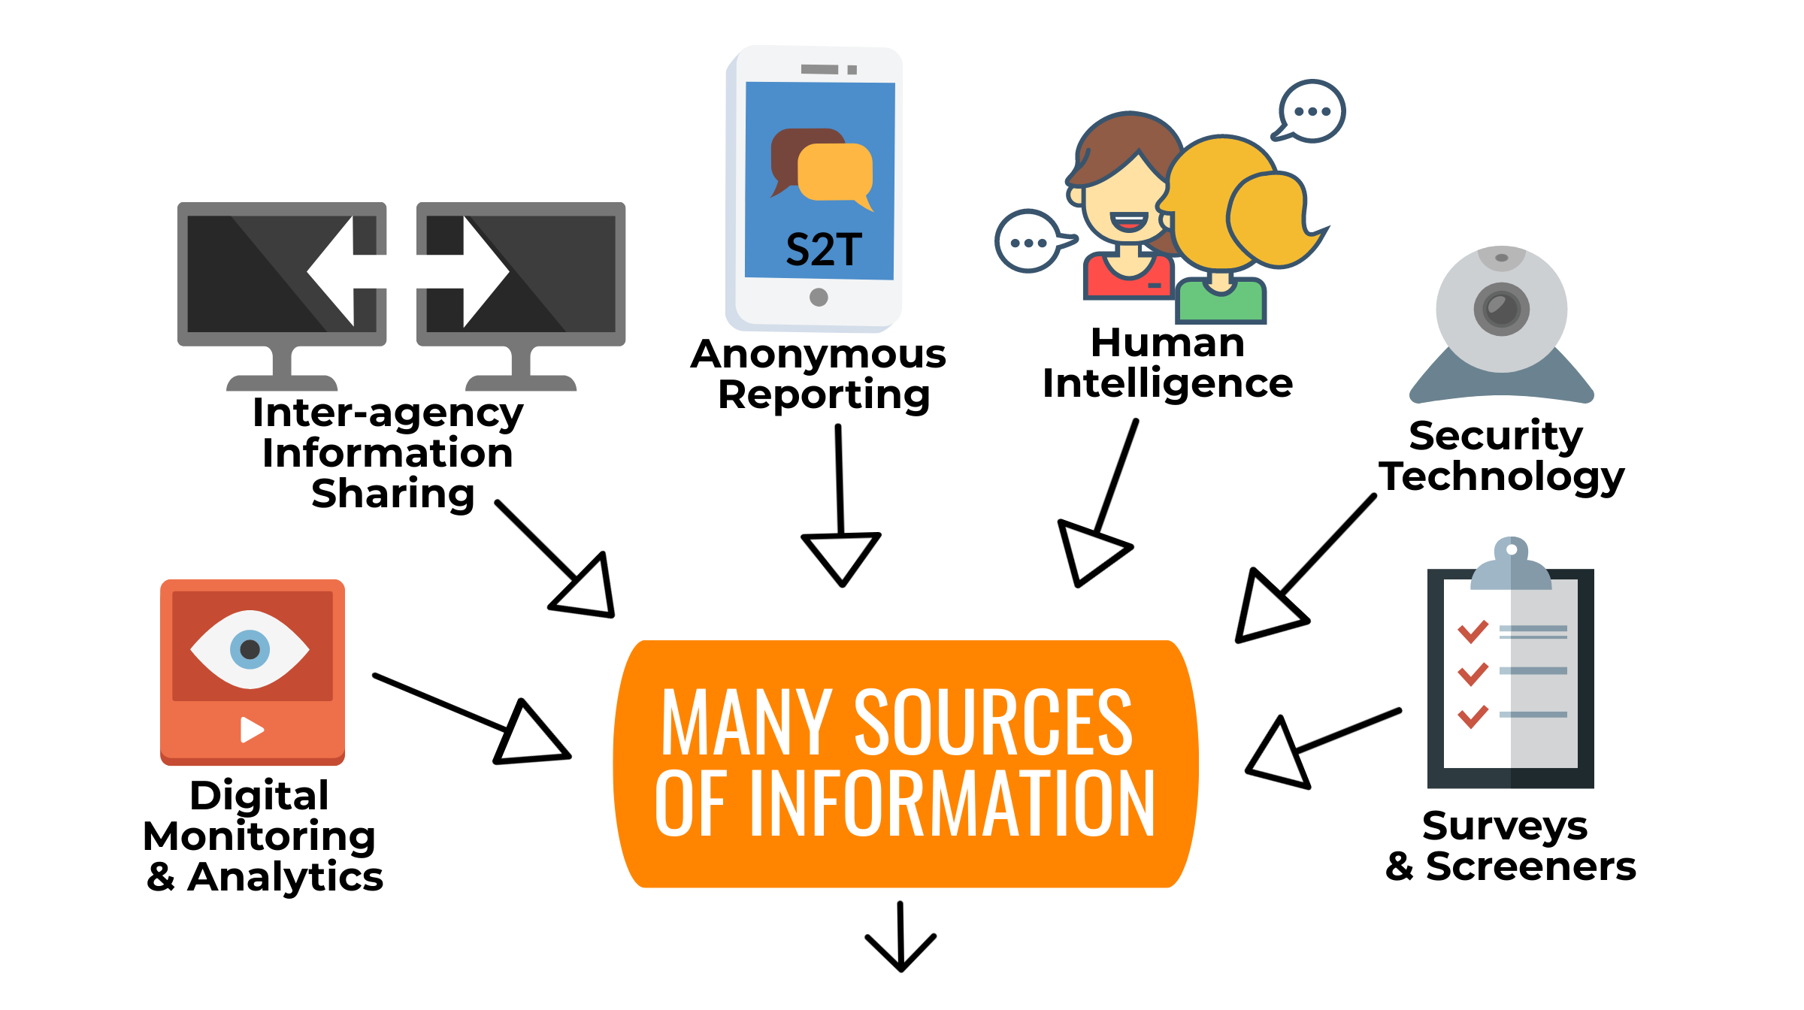

Slide 6


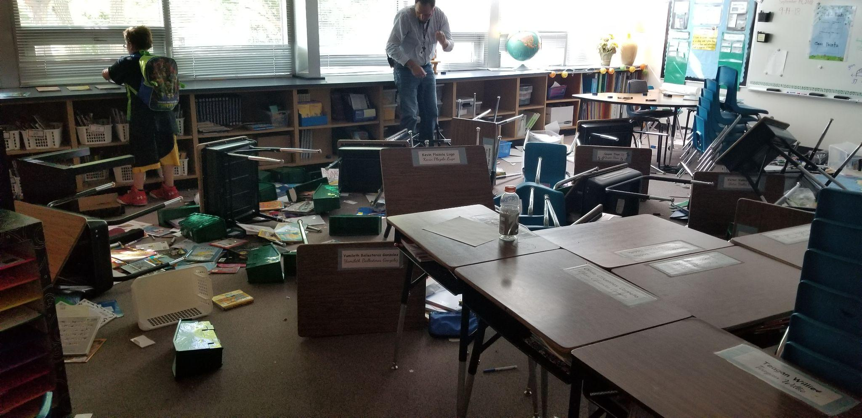
Do schools know how to respond when safety concerns arise?
8 year old is hitting, kicking, and
destroying the classroom
13 year old makes suicidal comments & has a knife
in her backpack
17 year old makes threats on social media

Slide 7

Mental Health
Model
Traditional Model
Standardized protocols
Assess and understand
Consider developmental needs
Use intervention agreements
Provide care and monitoring
Restorative opportunities
Reflexive decision making
Punishment without support
Lacks assessment or intervention
Ignores developmental needs
Overly restrictive placements
Parents feel alone and shamed

Slide 8

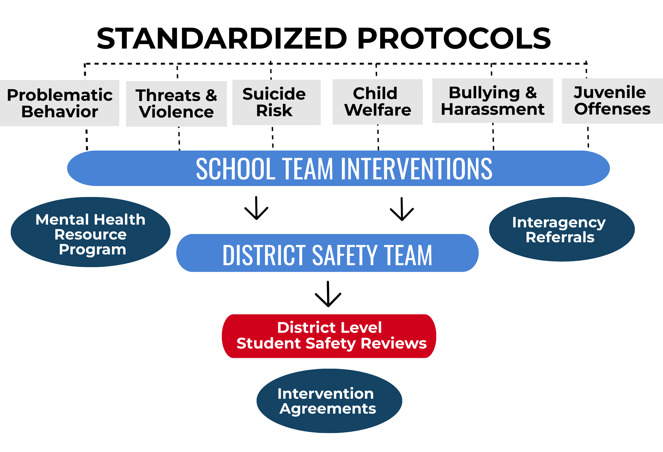
Notes:
Utilize structured tools and procedures
Address mental health needs immediately
Match interventions to developmental needs
Partner closely with families & community

Slide 9
Behavioral Dysregulation
Suicide
Concerns
Threats of Violence
Utilize PBIS, SEL and Brain Education for foundational skills
Consider environmental design to reduce reactivity
Train staff in verbal de-escalation and physical intervention techniques
Utilize Functional Behavioral Assessment and Behavior Intervention Plans
Use a brief gatekeeper training for all employees
Educate students on how to access support
Implement a Risk Intervention Protocol by trained specialists
Formalize safety plans and monitoring
Communicate with private providers
Train all employees in awareness and warning signs
Implement a multidisciplinary team model
Use structured Threat Assessment protocols to guide response
Create intervention agreements to avoid expulsion and increase participation in mental health services

Slide 10
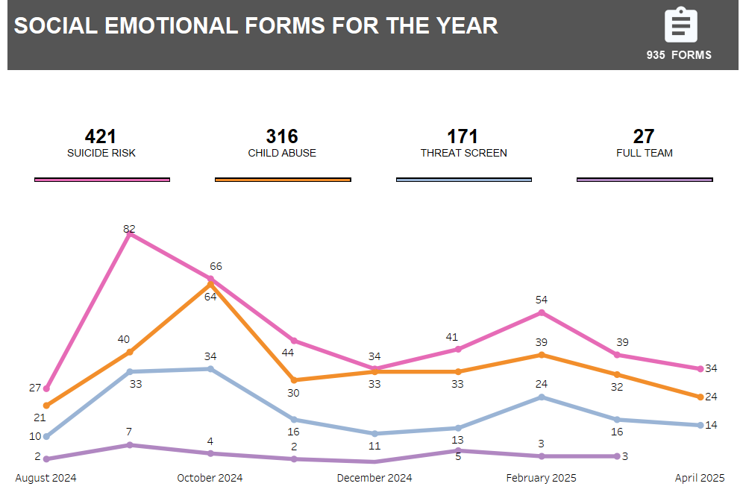
Safety Team
Dashboards
Total Interventions
by Month

Slide 11
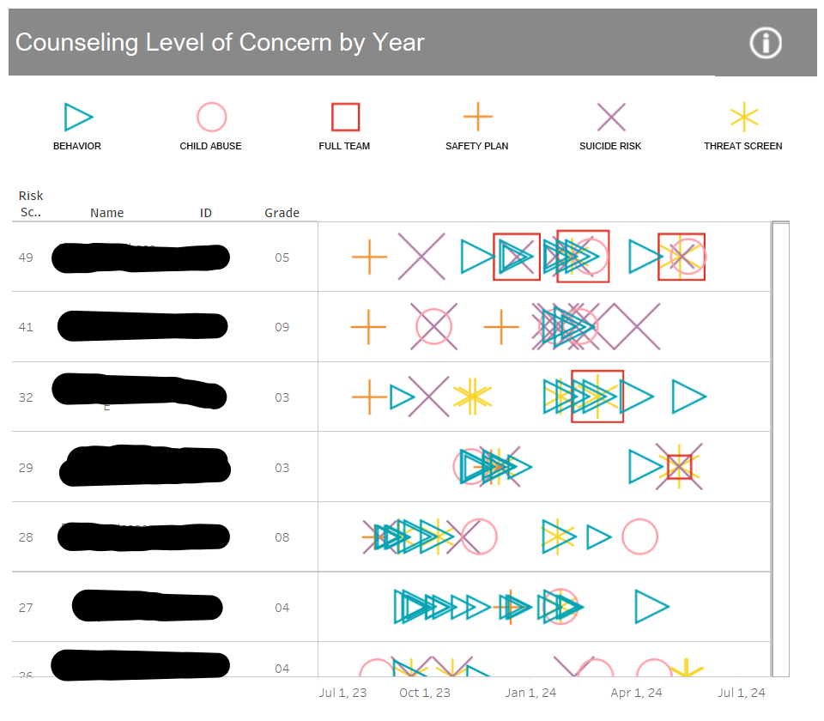
Safety Team
Dashboards
Interventions by
Individual Student

Slide 12
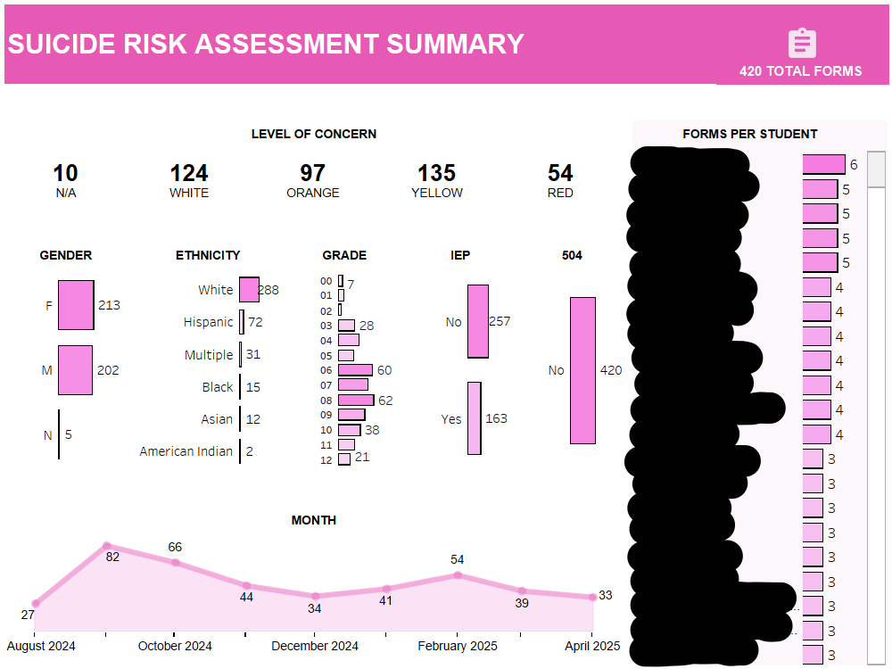
Safety Team
Dashboards
Suicide Risk Assessments

Slide 13
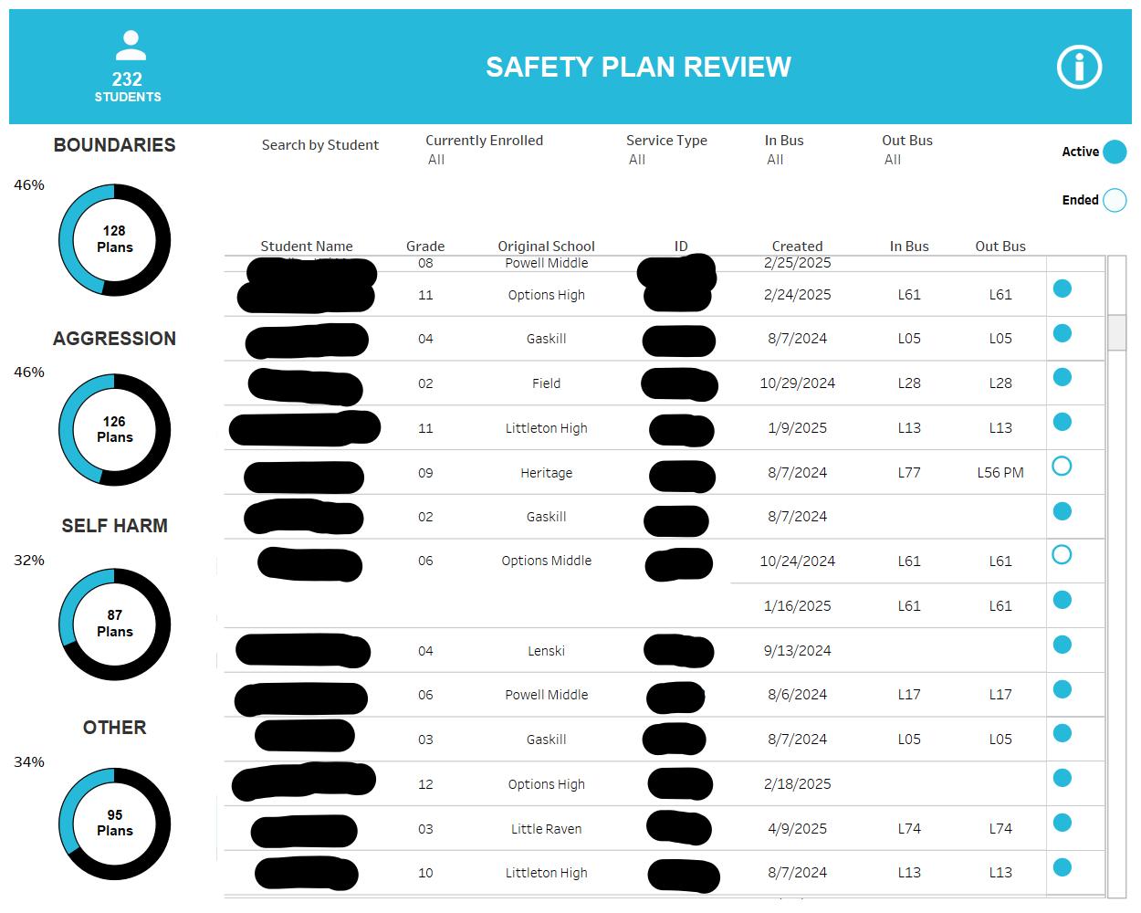
Safety Team
Dashboards
Safety Plans

Slide 14
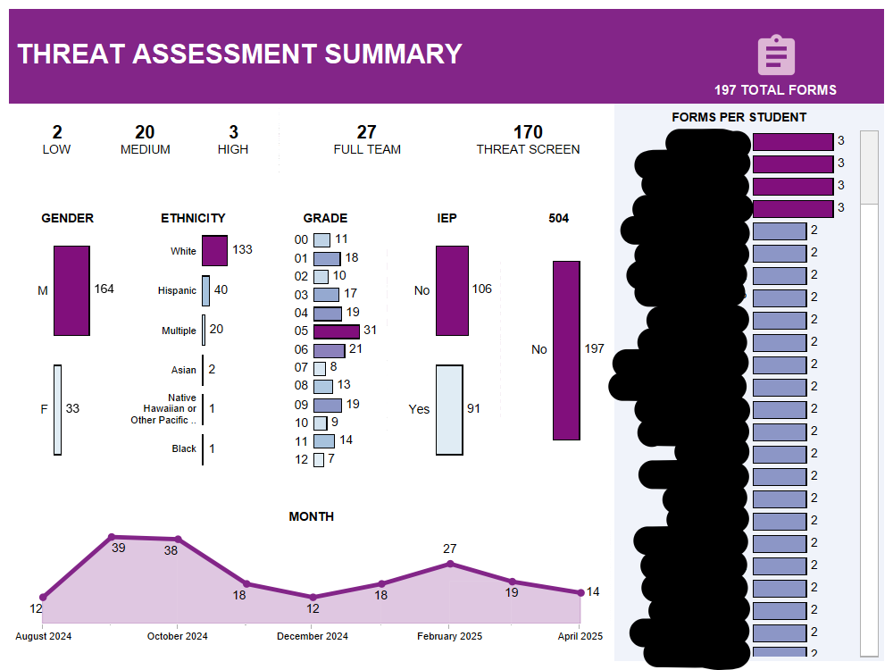
Safety Team
Dashboards
Threat Assessments

Slide 15
INTERVENTION & SUPPORT
PREVENTION & PROMOTION
POSTVENTION & RESPONSE
School Based
MTSS Teams
Targeted Group Interventions
District Consultants
Risk Protocols
Mental Health Resource Program
PBIS, SEL and
Brain Education
Staff Training
and Wellness
Climate, Safety and Wellness Surveys
Innovation
and Research
Crisis Response Team
Family Outreach
Triage, Support and Referrals
Debriefing
Prevention Through Recovery

Slide 16
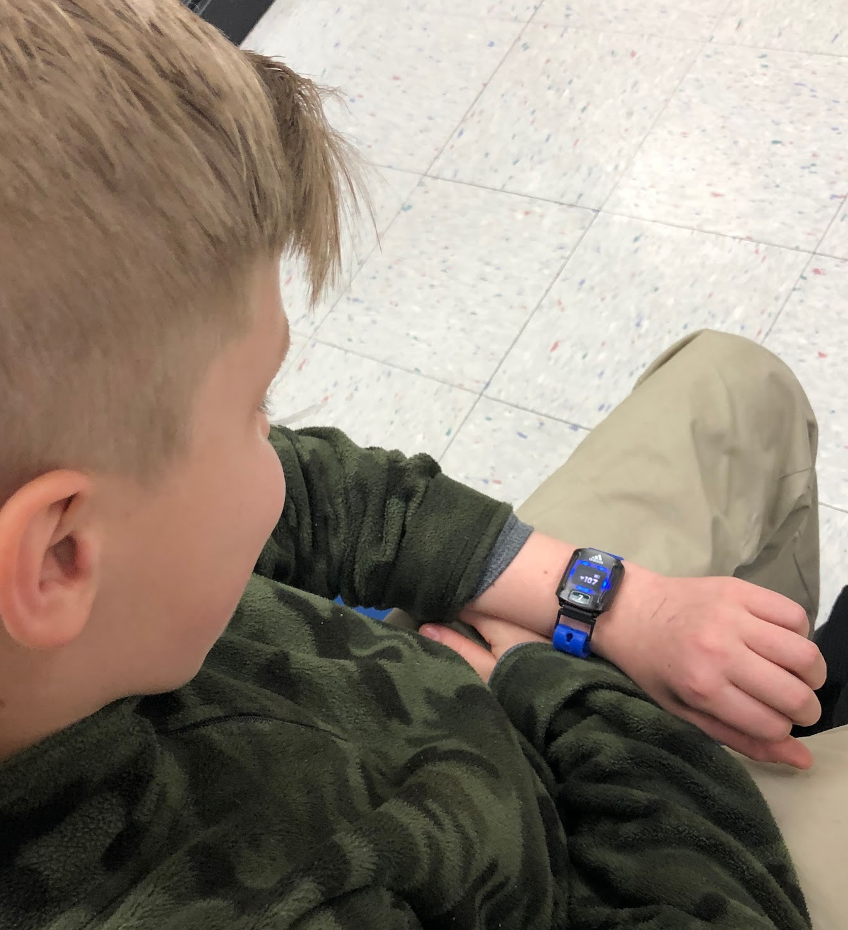
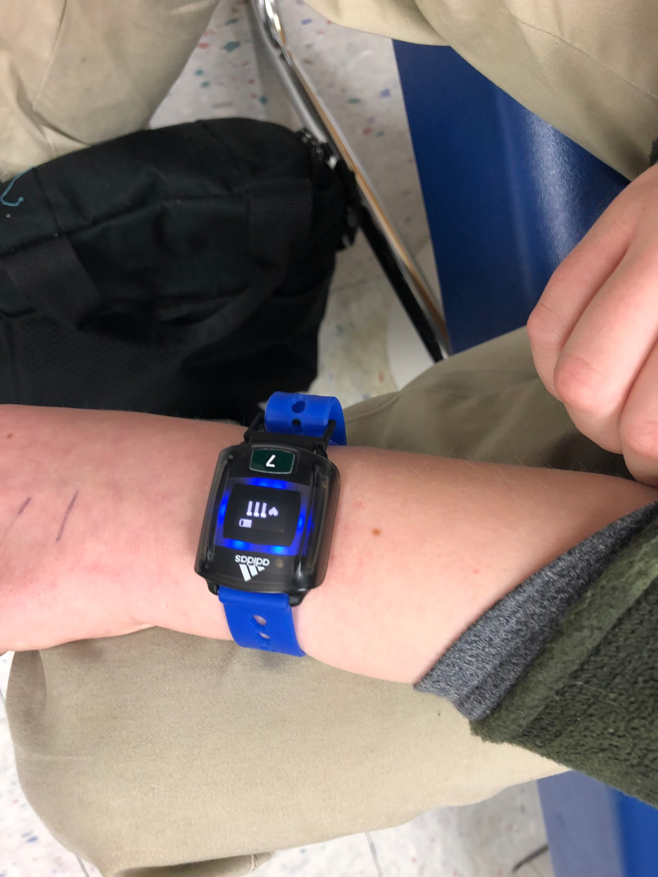

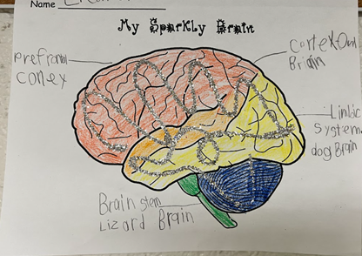



Brain-Focused Social Emotional Learning

Slide 17

Final Thoughts
1. Integrate mental health into all aspects
of school safety.
2. Invest in mental health specialists (in
schools and in system leadership).
3. Build a foundation with Social Emotional
Learning and Brain Education
4. Engage in regular collaboration and
planning between community
organizations.
Notes:
https://time.com/6187656/school-safety-mass-shootings/

